Slide 1
Stoichiometric Conversion of Cellulosic Biomass by in Vitro Synthetic Enzymatic Biosystems
Yingjie Pan
Institute for Theoretical Chemistry, TBI
Founded by the European Union
Department of Chemistry, the University of Vienna

Slide 2
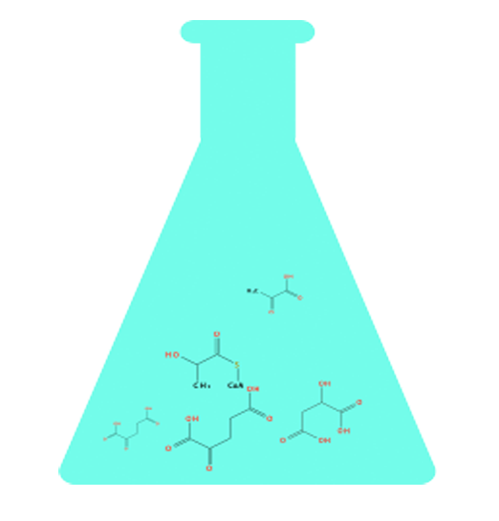
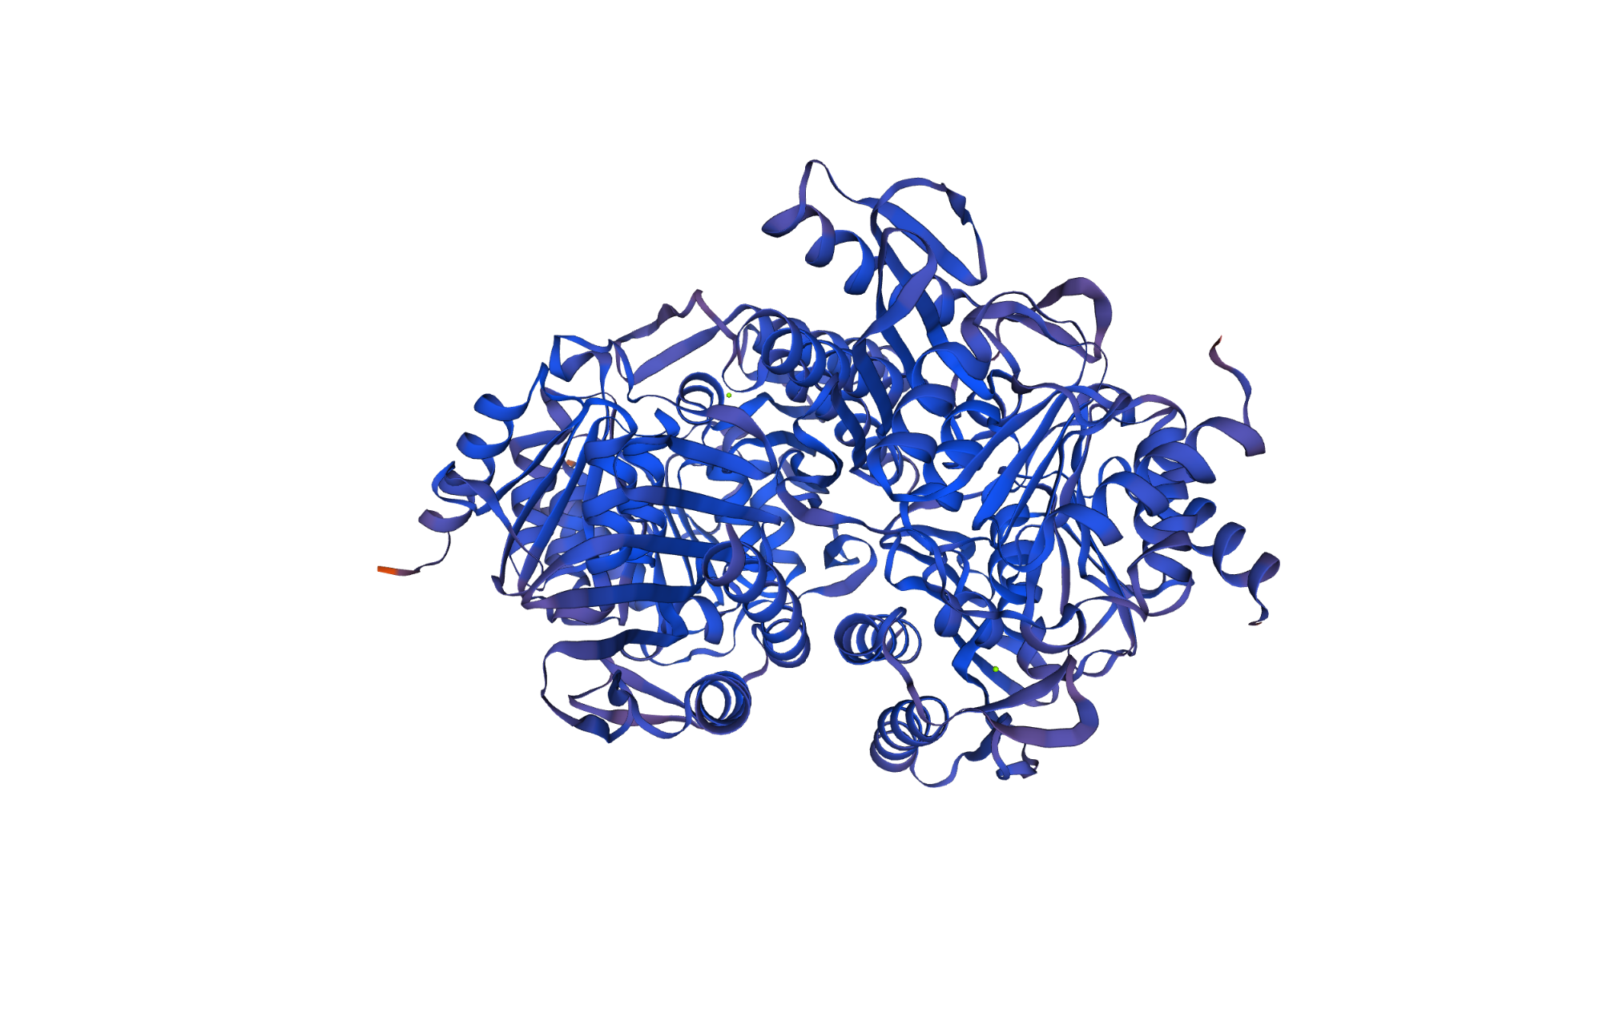
01
Overview
Design of Novel Pathways for Production of Bio-Based Chemicals in Multi-Enzyme Cascades
Substrate
Enzyme
Paracetamol

Slide 3
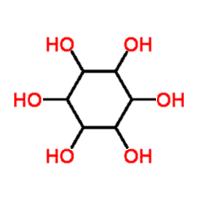
01
Target module
Human health
Medical industry
Food additives
Animal food

Slide 4
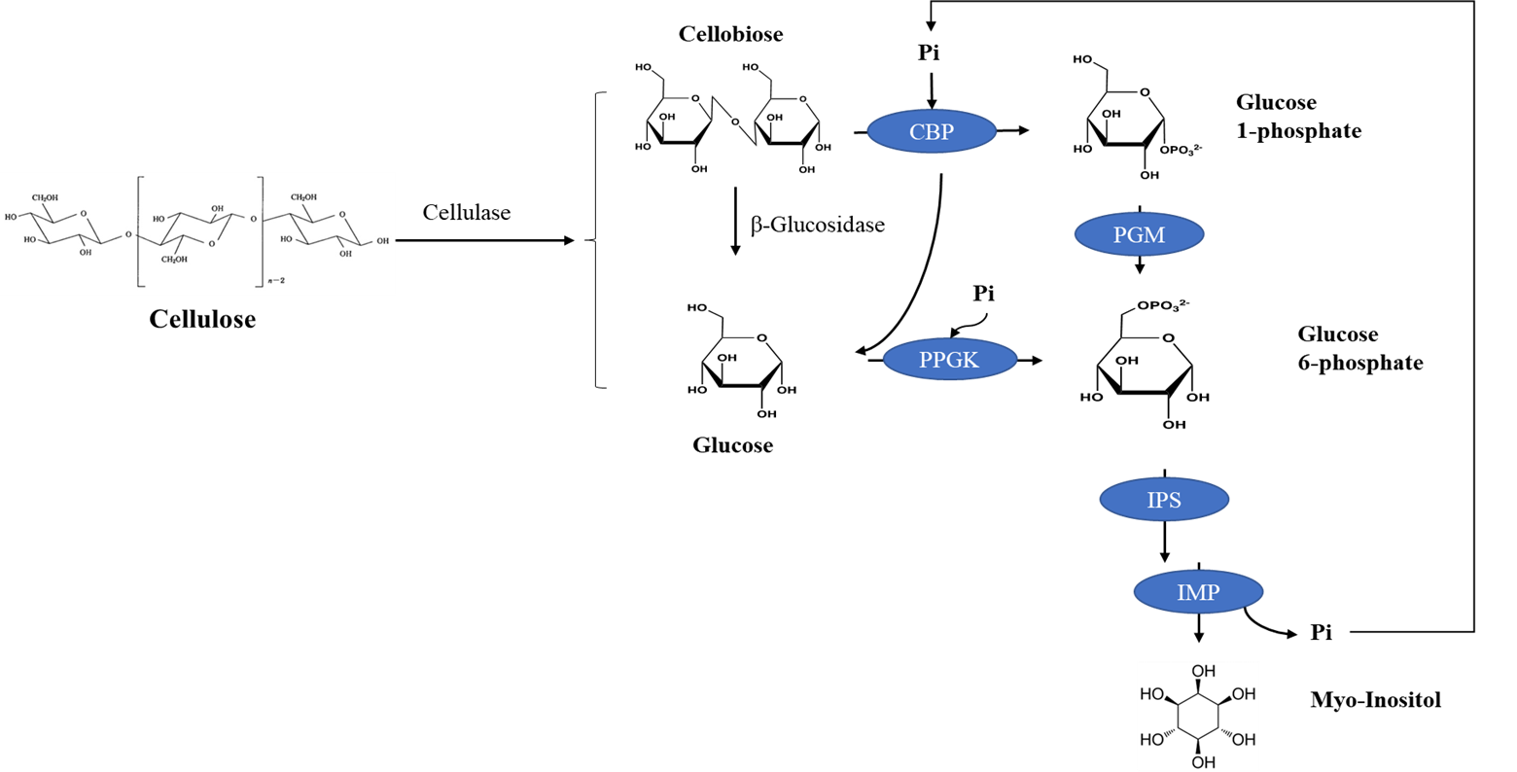
02
Enzymatic system
Figure 1. Schematic representation for the stoichiometric phosphorolysis of cellulosic biomass via an in vitro synthetic enzymatic biosystem. cellobiose phosphorylase (CBP), polyphosphate glucokinase (PPGK), phosphoglucomutase (PGM), inositol 1-phosphate synthase (IPS), and inositol monophosphatase (IMP). The metabolites are inorganic phosphate (Pi) and polyphosphates (Pi)n and (Pi)n−1.[1]

Slide 5
03
Proteins
Table 1. Information for the Enzymes Used in This Study
Enzyme | EC no. | source | Gene locus | purification | Sp act(U/mg) | Temp(℃）
cellobiose phosphorylase (CBP) | 2.4.1.20 | C.thermocellum | Cthe_0275 | His/NTA | 5 | 55
polyphosphate glucokinase (PPGK) | 2.7.1.63 | T. fusca | Tfu_1811 | His/NTA | 310 | 55
phosphoglucomutase (PGM) | 5.4.2.2 | T.kodakaraensis | TK_1108 | heat precipitation | 55 | 55
inositol 1-phosphate synthase (IPS) | 5.5.1.4 | A. fulgidus | AF_1794 | heat precipitation | 0.9 | 55
inositol monophosphatase (IMP) | 3.1.3.25 | T. maritima | TM_1415 | heat precipitation | 30 | 55

Slide 6
04
Host strain
Yeast
Protein transcription and translation,
folding and post-translational Modifications
Pichia pastoris
AOX1 promoter
Low cost
Fast growth
High-density cultivation
Very little self-protein, easy to
purify heterologous proteins
pPICzα
Secreted plasmid
Secreted expression

Slide 7
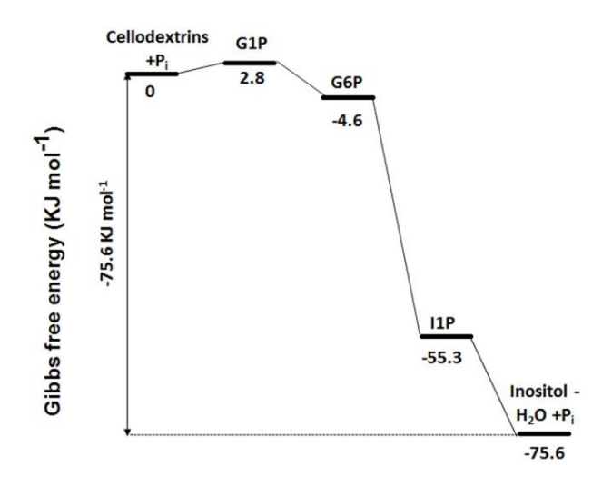
05
Possibility
Figure 2. An energy diagram showing standard Gibbs free energy change in each step of the enzymatic pathway for inositol production from cellodextrins under conditions of pH 7.5 and 0.1 M of ionic strength.

Slide 8
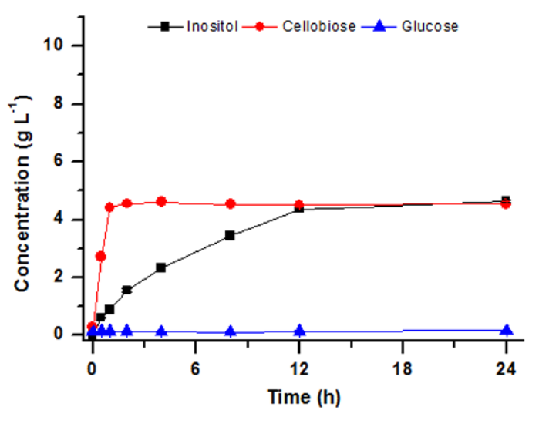
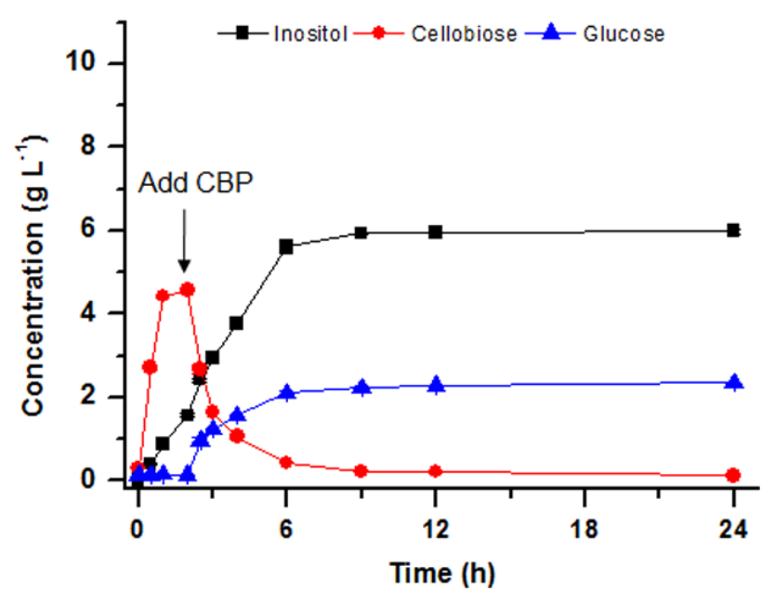
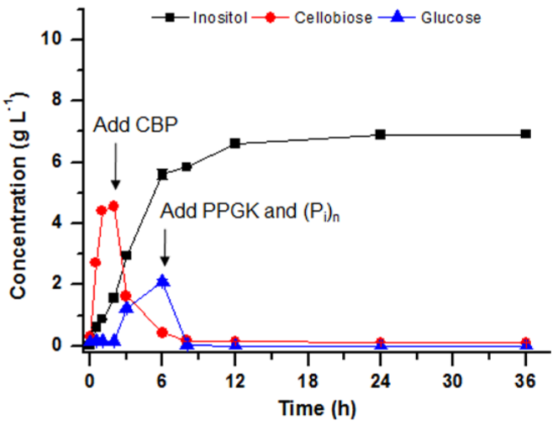
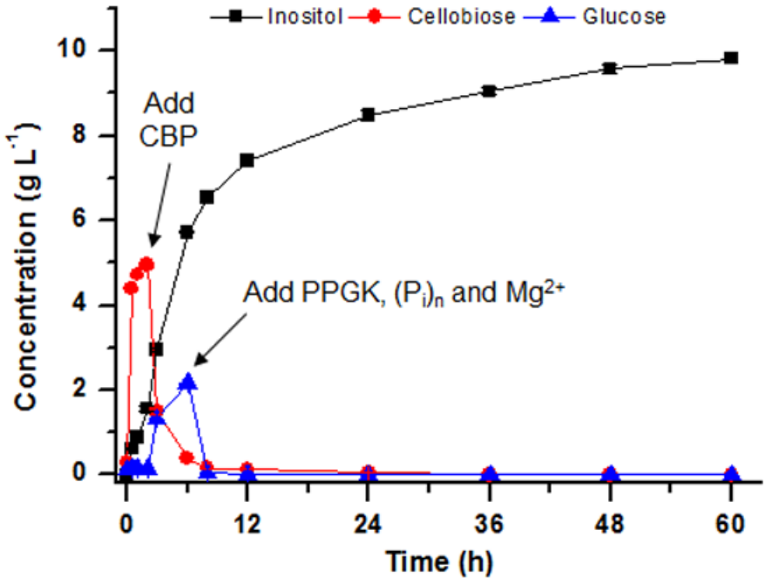
06
Optimization
Figure 3.. Phosphorolysis of 10 g L-1 of cellulose to inositol by a six-enzyme synthetic biosystem containing cellulase, CBP, PPGK, PGM, IPS, and IMP. (A) Profile of inositol synthesis from cellulose catalyzed by 6 enzymes at 55 °C. (B)Profile of inositol synthesis from cellulose catalyzed by five enzymes (CDP, CBP, PGM, IPS, and IMP) at 55 °C. CBP was added into the reaction system at hour 2.(C) Profile of inositol synthesis from cellulose catalyzed by six enzymes at 55 °C. CBP was added into the reaction system at hour 2, and PPGK and polyphosphate ((Pi )n) were added into the reaction system at hour 6. (D) Phosphorolysis of cellulose to inositol by a six-enzyme synthetic biosystem containing at 55 °C supplemented with 15 mM additional Mg2+ along with PPGK and polyphosphate ((Pi )n) at hour 6.

Slide 9
THANKS
Yingjie Pan
Institute for Theoretical Chemistry, TBI
Department of Chemistry, the University of Vienna

