Slide 1
A Bayesian Classifier Approach to Causal Inference in Complex Adaptive Systems
Christopher R. Stephens
C3- Centro de Ciencias de la Complejidad and Instituto de Ciencias Nucleares, UNAM
Centre for Complexity Science, Imperial College, London
Centro de Estudios Mexicanos UNAM-Reino Unido, King’s College, London
41st TBI Winterseminar in Bled

Slide 2
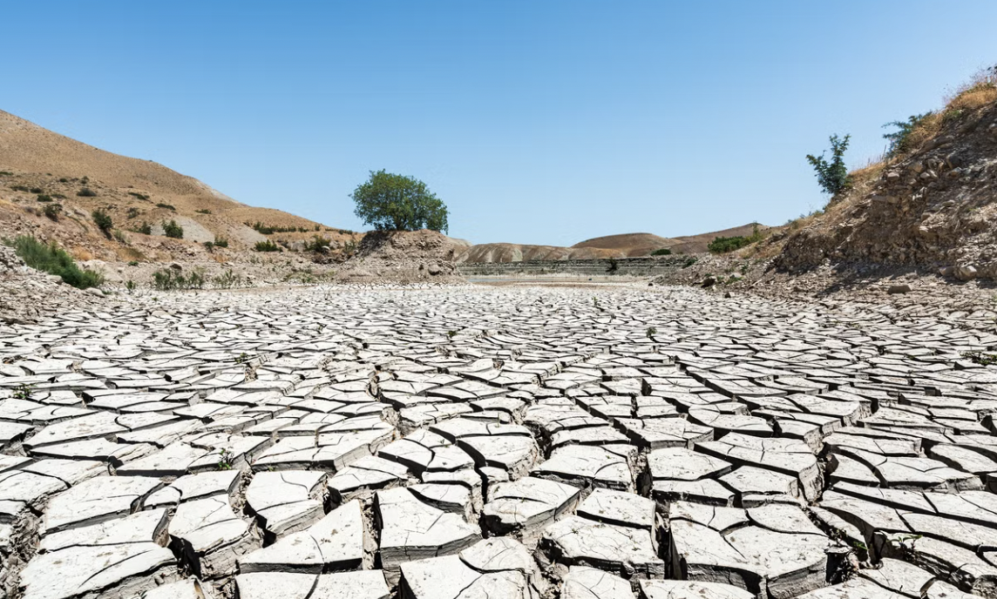
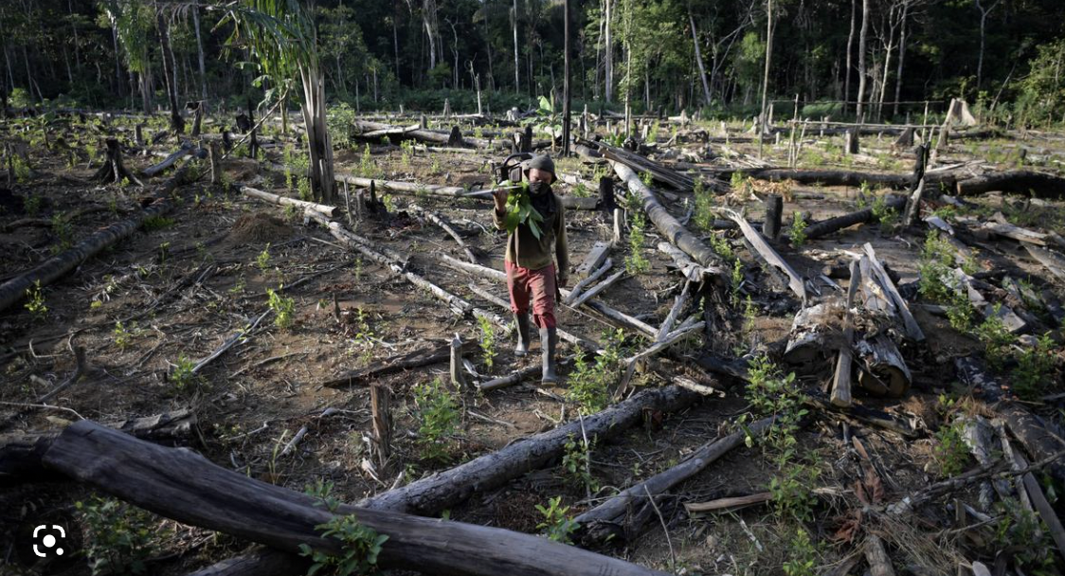
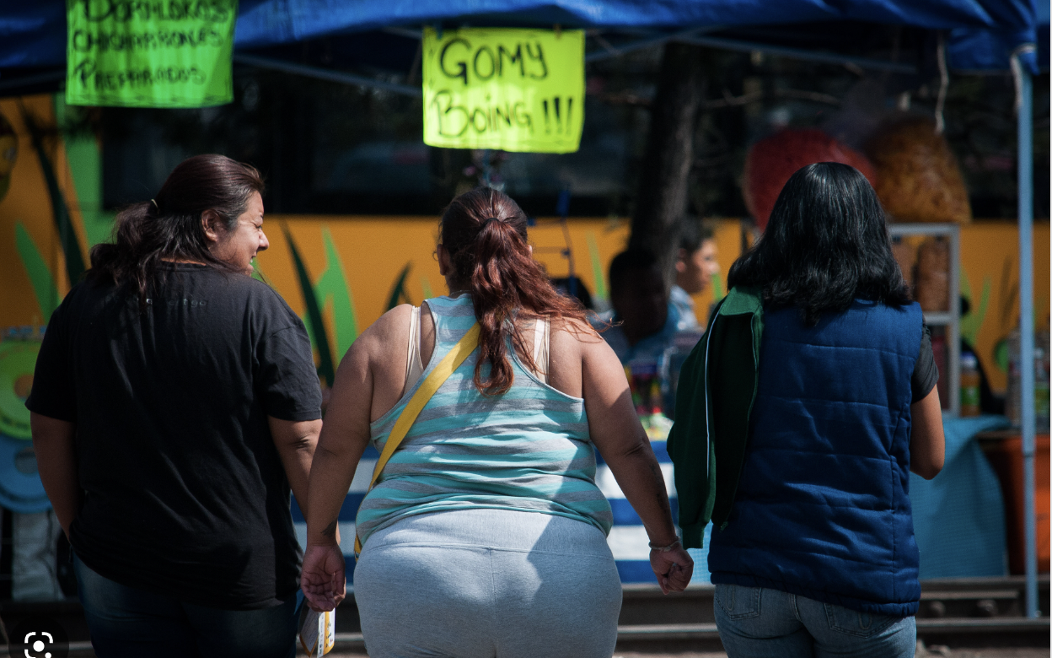

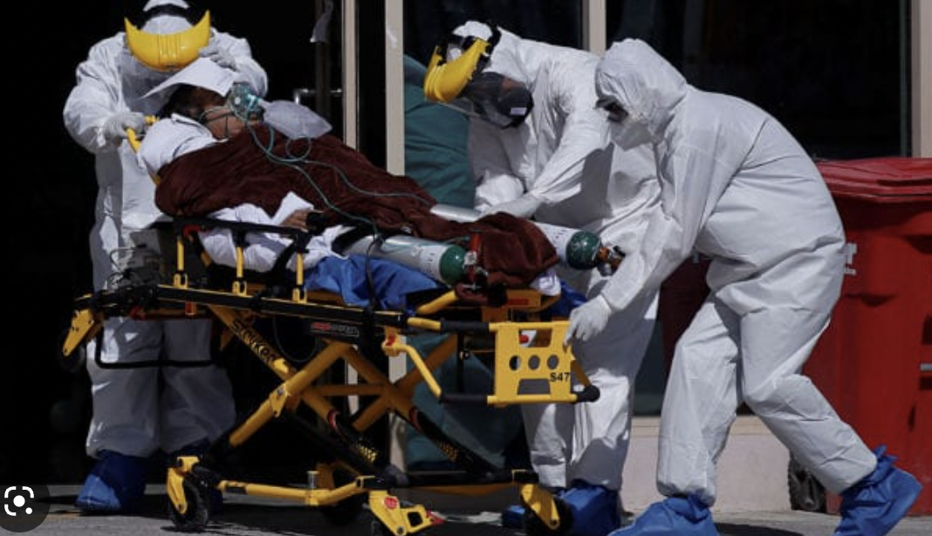
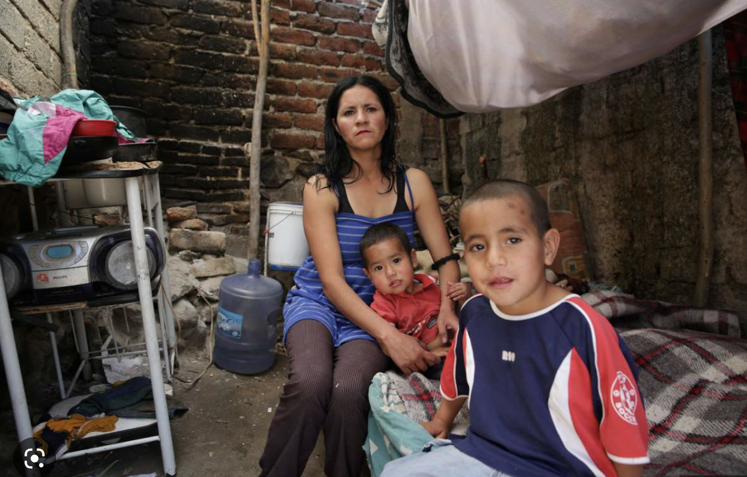

Some pretty important problems…
Climate change
Biodiversity loss
Obesity and metabolic
diseases
Emerging and unattended diseases
Gender violence
New pandemics
Poverty
Notes:
More often than not we take a bottom up approach to science – especially basic science. – whereby we have an hypothesis in a relatively low dimensional space (ie involves few factors) and relations between them. Genetics to some degree is a bit different as it’s a bit more discovery based because it’s a bit harder to have a Bayesian prior about which genes are important. Here I want to take a top down approach and say here’s a major problem. How do I model it and then use those models to create interventions that mitigate or solve the problem.

Slide 3
What do they have in common?
1) They’re all Complex Adaptive Systems
2) They’re all our fault
3) They’re multiobjective
4) They’re not getting (much) better
Notes:
Every one of those problems is very different and is studied by very different disciplines. However, lets take a step back and ask what they have in common. The fact that they’re not getting better is becaue of the previous properties.

Slide 4
1) They’re all Complex Adaptive Systems
“Complex” = Extremely multifactorial/multicausal
  There are many things you can say about a CAS and each thing you say depend on many other things
“Adaptive” = Live in a space of configurations AND rules, strategies, laws, behaviours
  The “laws” of physics and chemistry change from being “explainers” to being restrictions.
P(C|X(t))
The “World” – causes, risk factors, environment,…
Who, What, Where, When,…
Notes:
I would claim that almost any question can be put into this form - everything is classification

Slide 5
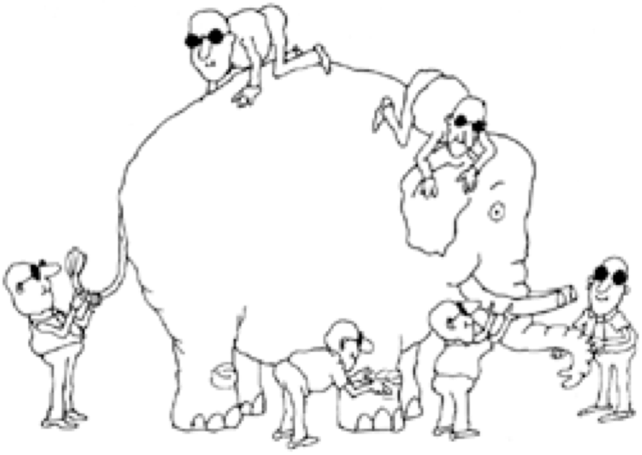

a) “Complex”
Now, imagine thousands of blind men...
from different disciplines and with incomplete, partial data
SNP FTO
Geneticist
Bioinformatician,...
Microbiome
Endocrinologist,Bacteriologist,...
Obesity
Sedentaryness
Socio-economic status
Fetal nutrition
Overeating
Sociologist
Economist,...
Urban planners,
Sports scientists,...
Psychologist,
Nutritionist,
Marketer,...
Maternal-fetal nutrition specialist
Notes:
Complexity – multifactoriality/multicausality implies multiscale and multidiscipline. It also implies enormous challenges for data collection. Emphasise that this elephant is equally valid for ANY CAS. Just because we are working with a CAS that doesn’t mean we’re accounting for its complexity or its adaptability. In other words oyu can have a model of a CAS that is neither complex nor adaptive. IT could also be correct –like Newton’s laws.

Slide 6
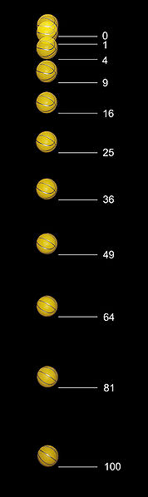
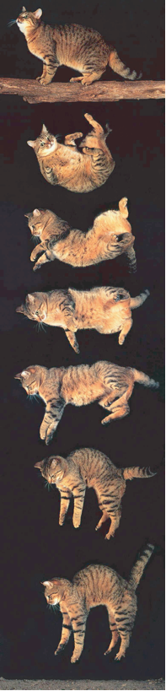
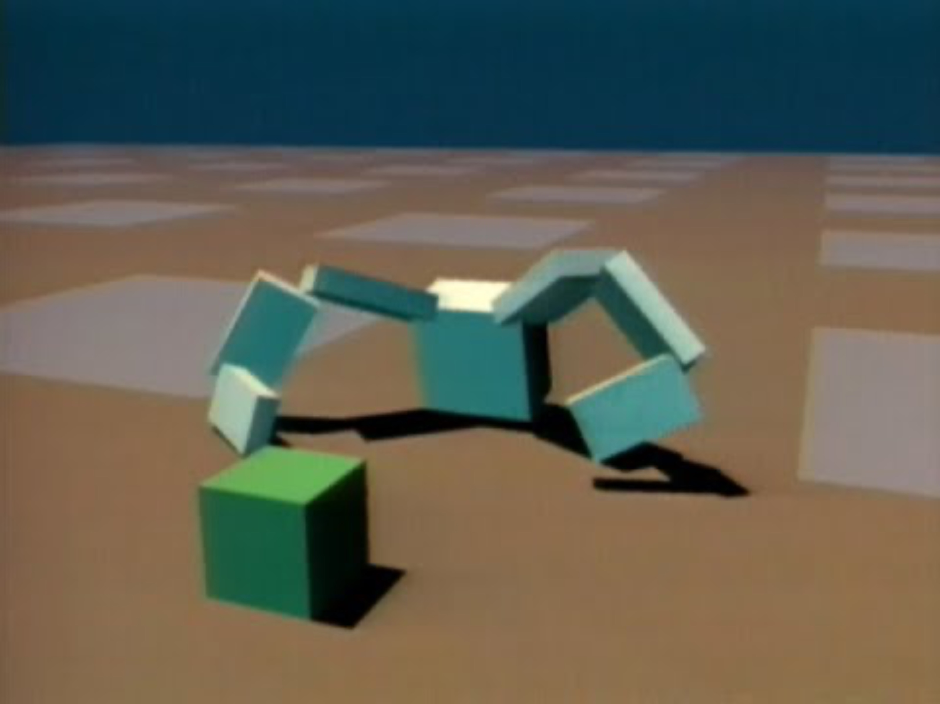
b) “Adaptive”
Mechanistic
Adaptive
Both systems obey Newton’s 2nd Law. This is enough to describe the motion of their centers of gravity but doesn’t tell us how or why the cat lands feet first.
In the first case Newton’s laws explain the phenomenon but in the second case they become a restriction to be obeyed.
Dogs, cats and balls all have different rules when falling from a tree. For CAS we can call them behaviours
Notes:
. Just because we are working with a CAS that doesn’t mean we’re accounting for its complexity or its adaptability. In other words oyu can have a model of a CAS that is neither complex nor adaptive. IT could also be correct –like Newton’s laws.

Slide 7
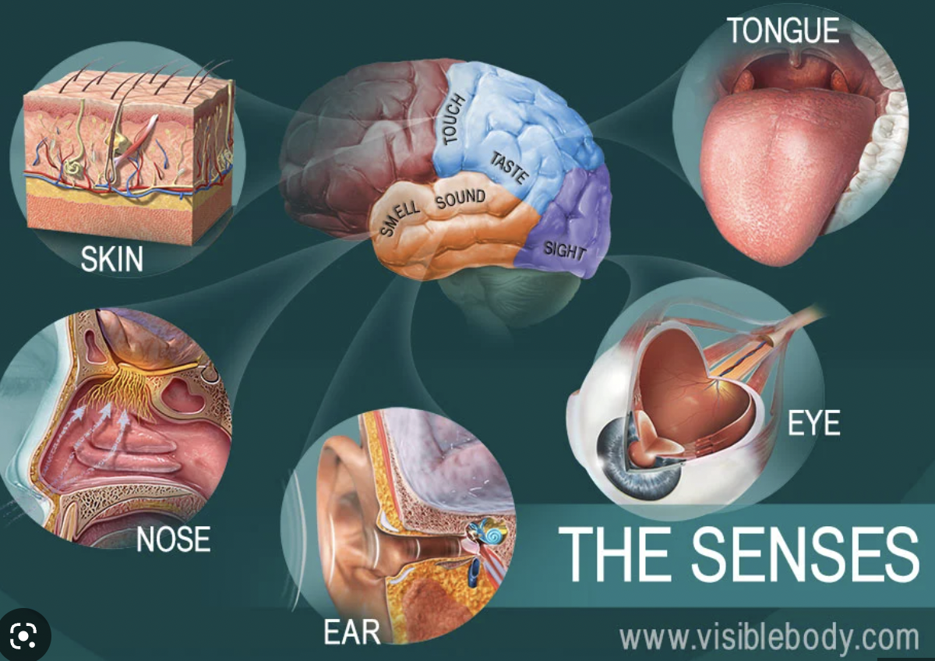
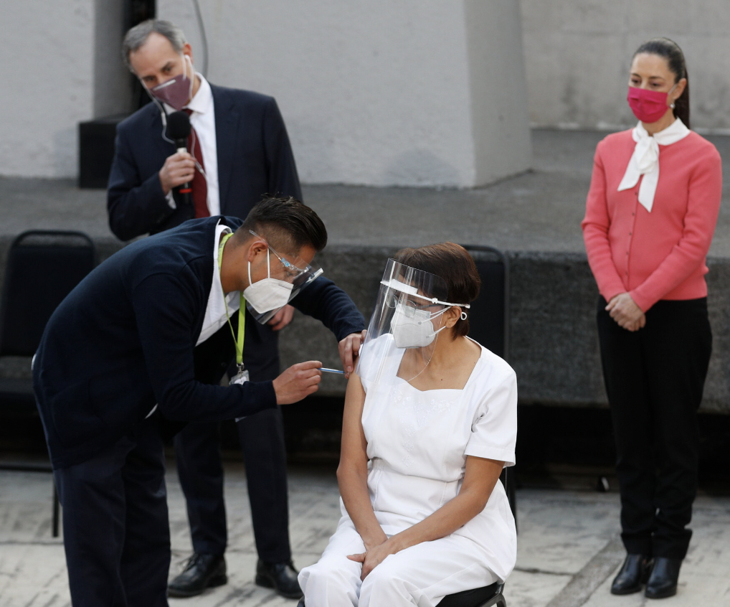

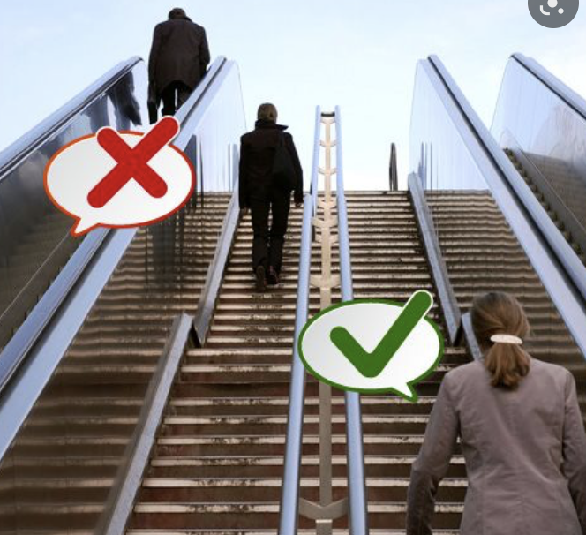
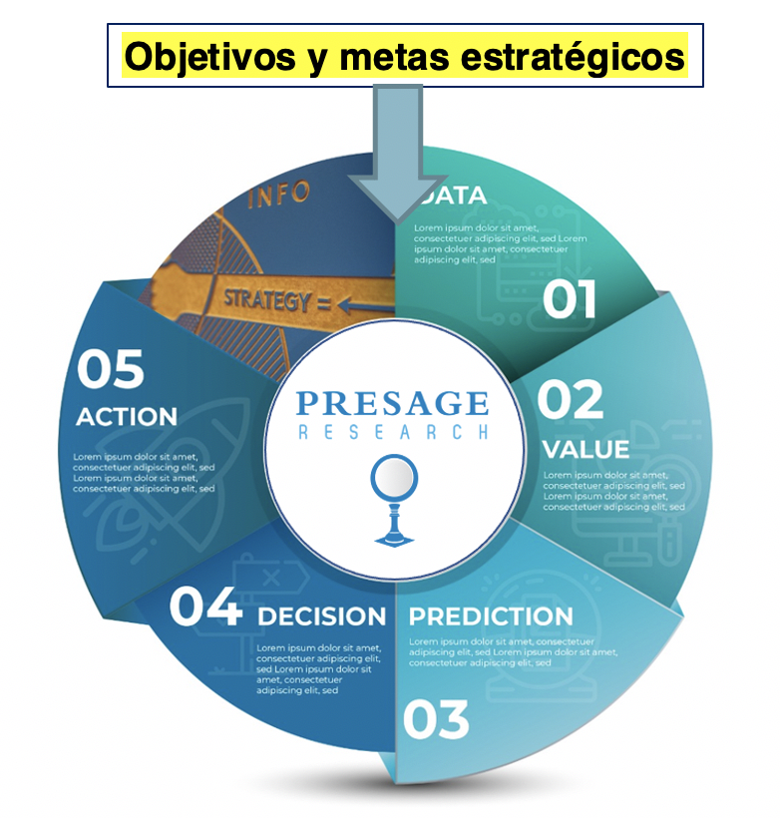
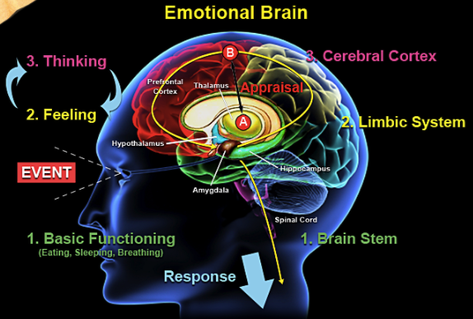
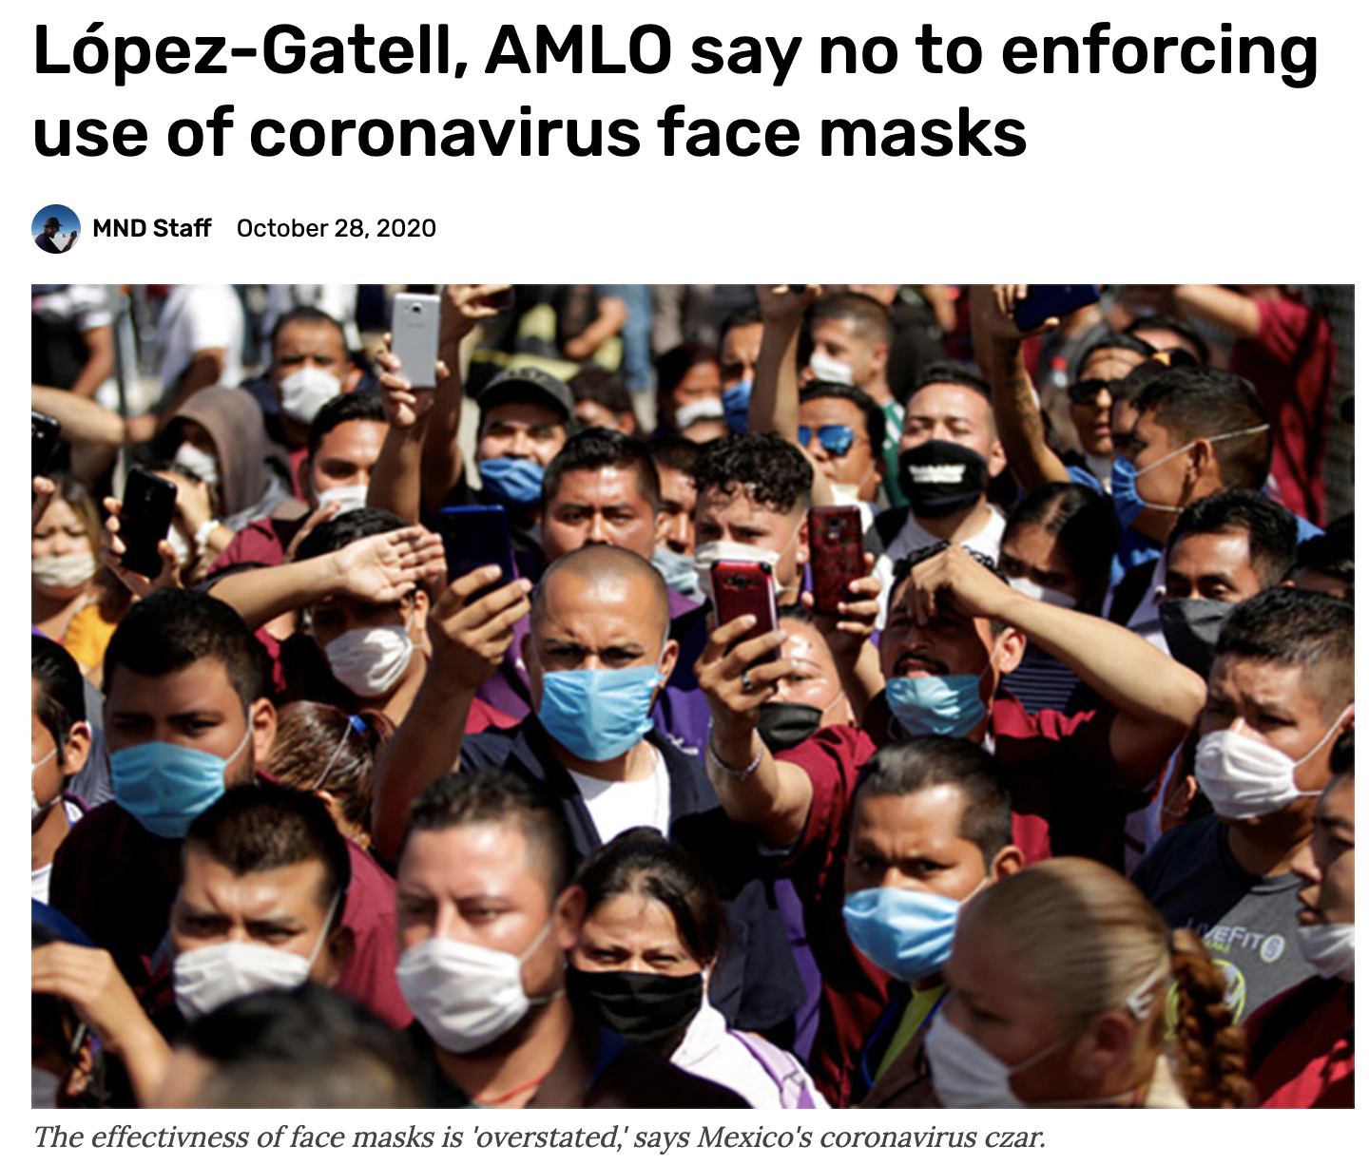
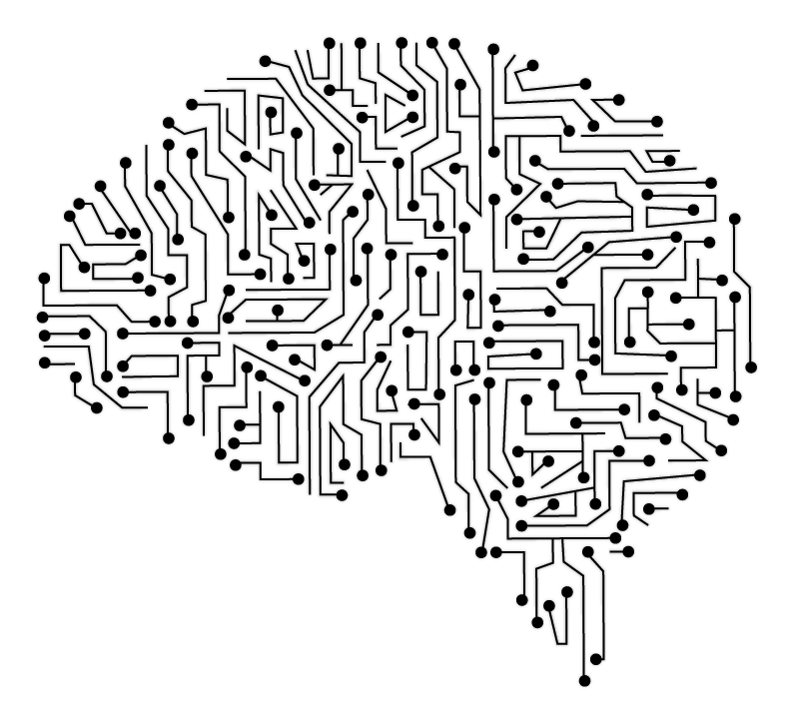
2) They’re all our fault
Limited symbolic processing power ~ 30 bytes/sec
We don’t speak "database"
Consequences
Computers don’t “understand" anything
Produces “machines” - specialists
Human Intelligence
Decision
Cycle
Hybrid Intelligence
P(C|X)
Where? Who? What? When?
Artificial
Intelligence
Notes:
They’re all our fault. Prinicipally by bad decisions/actions – behaviours/conducts. We can basically take this as a model of evolution itself. Its what every organism has to do. Every organism has to predict in its environment and use sensorial data as an input to those. models.

Slide 8
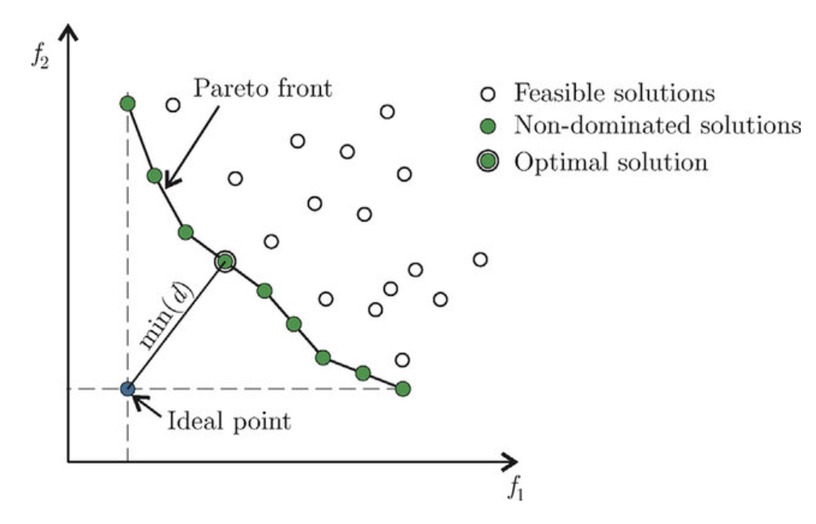
3) They’re all multiobjective
When is a decision “good” versus “bad”?
We need a metric to measure it.
“Rational” decision making implies that there is a unique utility function that we optimize
What is the utility function here?
DT = the time difference between taking the stairs and taking the elevator?
DE = the difference in physical energy expended in one route versus another?
DH = the relative perceived health benefit of one versus the other (think how this can change pre-COVID versus post-COVID!)?
DS = the socialization benefit in the case you would take one versus the other with coworkers?
Others?
How do we balance these tradeoffs and make our decision?

Slide 9
What are the ingredients in creating a general framework for modelling these problems?
An appropriate conceptual, theoretical and algorithmic framework
“Deep”, commensurable data sets
A different way to how we do science now

Slide 10
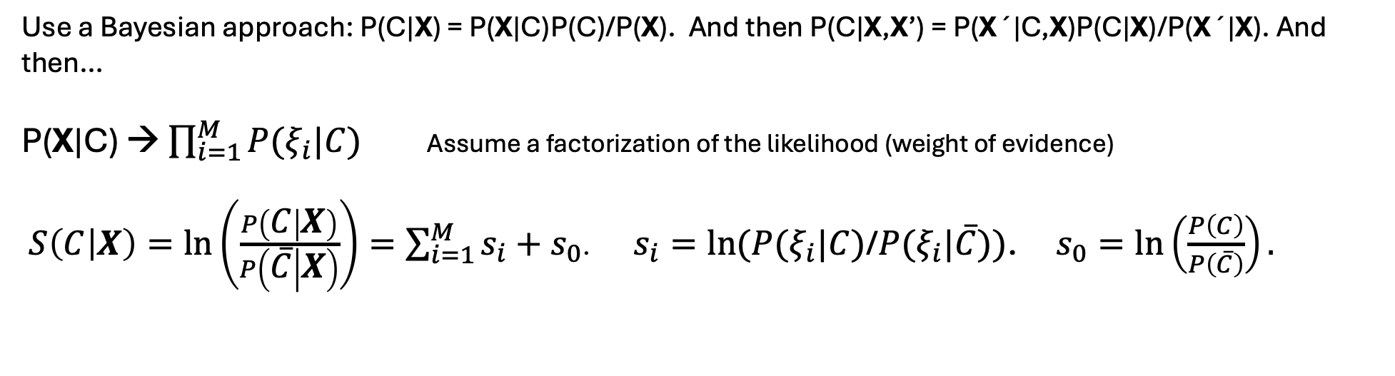
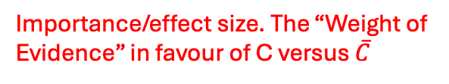
The Bayesian Models
P(C|X) = P(C|X₁, X₂,…, X_{N})
X = (X₁, X₂,…, X_{N})
As a number this can tell us the probability of the “effect” given the “causes” X. It won’t tell us the “whys”.
For the Decision Cycle we need to know the “whys” - which X_{i} are:
        Important
        Believable (statistically)
    Causal (direct, indirect, very indirect,…)
    Actionable (is it a variable we can change, e.g., climate or age = no, government program or diet = yes)
Use a Bayesian approach: P(C|X) = P(X|C)P(C)/P(X). And then P(C|X,X’) = P(X´|C,X)P(C|X)/P(X´|X). And then…
P(X|C) → $\prod_{i=1}^{M}{P(ξ_{i}|C)}$ Assume a factorization of the likelihood (weight of evidence)
$S\left(C | X\right)=\ln\left(\frac{P\left(C | X\right)}{P\left(\overline{C} | X\right)}\right)=\sum_{i=1}^{M}{s_{i}+s_{0}}$. $s_{i}=ln⁡(P(ξ_{i}|C)$/$P(ξ_{i}|\overline{C}))$. $s_{0}=\ln\left(\frac{P\left(C\right)}{P\left(\overline{C}\right)}\right).$
Importance/effect size. The “Weight of Evidence” in favour of C versus $\overline{C}$
Bayesian prior
This is a generative not a discriminitive classifier – depends on the distribution of X
Notes:
There are many algorithms for modelling P(C|X) from a logistic regression to a DL NN. These can change in space and time
Are multimodal/multiformat/multiscale (ordinal, nominal, interval etc.)
Are located in very different data sources
Are properties of what the ensemble element “is” (weight, sex, father has diabetes, etc.) and what the element “does” (exercises regularly, eats more than the recommended amount etc.) Everything is coarse grained. Exercise/no exercise versus a detailed description of the exercise.
ALL variables are discretised into a number of bins at the same scale with each bin treated as an independent variable.
Not only do we have a large number of variables to include but an even larger of models. If I have N features then I have N*2^N possible models.

Slide 11
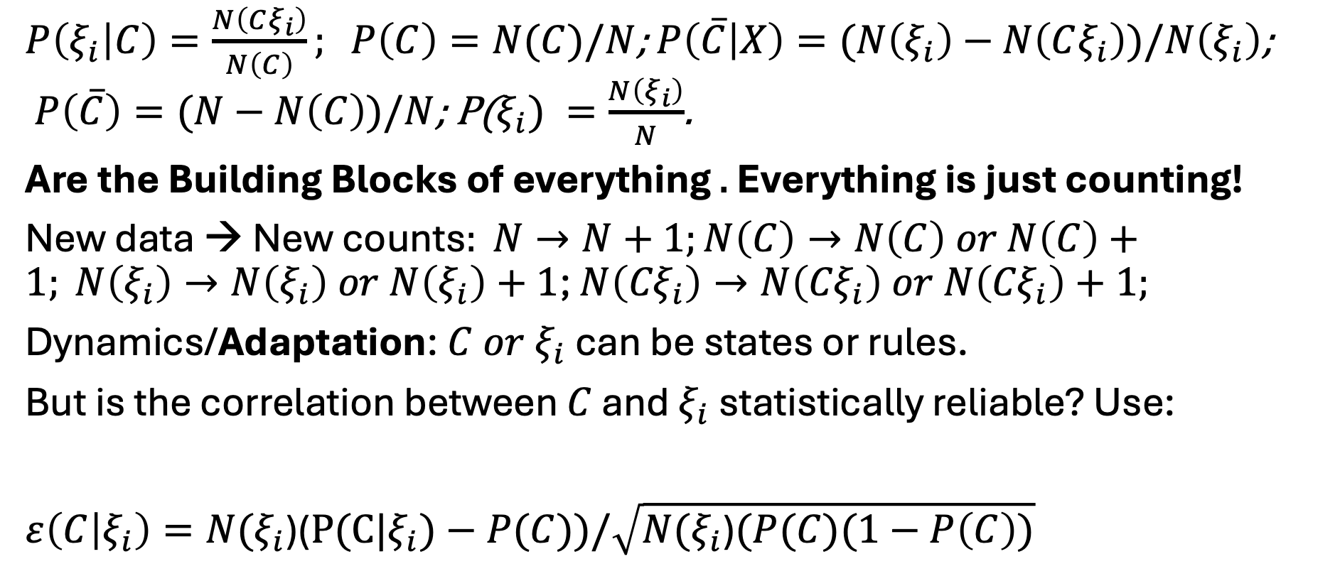
The Bayesian Models
$P\left(ξ_{i} | C\right)=\frac{N\left(Cξ_{i}\right)}{N\left(C\right)}; P\left(C\right)=N(C)/N$; $P\left(\overline{C} | X\right)=(N\left(ξ_{i}\right)−$ $N\left(Cξ_{i}\right))/N\left(ξ_{i}\right)$; $P\left(\overline{C}\right)=(N−N\left(C\right))/N$; P($ξ_{i}) =\frac{N\left(ξ_{i}\right)}{N}$.
Are the Building Blocks of everything . Everything is just counting!
New data → New counts$: N→N+1;N\left(C\right)→N\left(C\right) or N\left(C\right)+1; N\left(ξ_{i}\right)→N\left(ξ_{i}\right) or N\left(ξ_{i}\right)+1$; $N\left({Cξ}_{i}\right)→N\left({Cξ}_{i}\right) or N\left({Cξ}_{i}\right)+1;$
Dynamics/Adaptation: ${C or ξ}_{i}$ can be states or rules.
But is the correlation between $C$ and $ξ_{i}$ statistically reliable? Use:
$ε\left(C | ξ_{i}\right)=N(ξ_{i}$)($P(C|ξ_{i})−P(C))/\sqrt{N(ξ_{i}\text{)}(P(C)(1−P\left(C\right))}$
We are comparing the relation between C and $ξ_{i}$ with the null hypothesis P(C)
Notes:
Everthing is just counting elements of a statistical ensemble.- occurrences and co-occurrences measured relative to a hierarchy of null hypotheses. What are the elements of the ensemble - things - people, animals, bacteria; or events - discrete elements of space/time

Slide 12
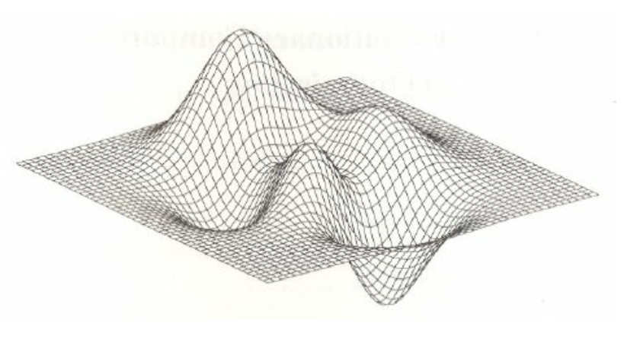
Concepts – The PREDICTABILITY Landscape
(CONDUCTOME in the case that C is a behaviour/conduct)
Conduct/behavior change means How do we move someone from here to here?
moving someone on this landscape
How easy is it?
Reduce cognitive stress versus
5 more years of education?
Drink the Coke
The PREDICTABILITY-CONDUCTOME Landscape is dynamic and adaptive.
Each Problem-Decision-Action-Conduct has its own Landscape
P(C(t)|X(t))
Don’t drink the Coke
Decision/action
threshold.
Above/below it its more/less likely you drink the Coke
Hours of exercise X₁
rs10885122_A X₂
(X₁, X₂) – Two Conductome dimensions (among many) – represents the state of the person (“who” and “what” - old/young, happy/sad,…) and/or environment (“where” and ”when” - at home/work, in Mexico/France,…)
Notes:
The space of features here is representing a space of configurations AND a space of behaviours. It is a Bayesian prior to specify what they are. There is a true landscape and then an approximation to it from a particular model. The true landscape represents the problem we’re trying to solve. Just like a fitness landscape we want to be able to describe the evolving geometry. Normally with a fitness landscape fitness is given as an explicit or implicit function, e.g., spin model, Nk model, TSP etc . For the predictability landscape we have to infer it from a finite set of measurements. For classification it is often just above or below P(C ). Learning is effectively trying to arrive at a better and better fit. There are some problems where the predictability landscape is explicitly known – e.g. tic tac toe where for a given rule set you have the exact landscape – you can also change the rule set. There are deep questions about what is the best algorithm for a given predictability landscape - no free lunch theorem. Understanding epsitasis. Expansion in cumulants.

Slide 13
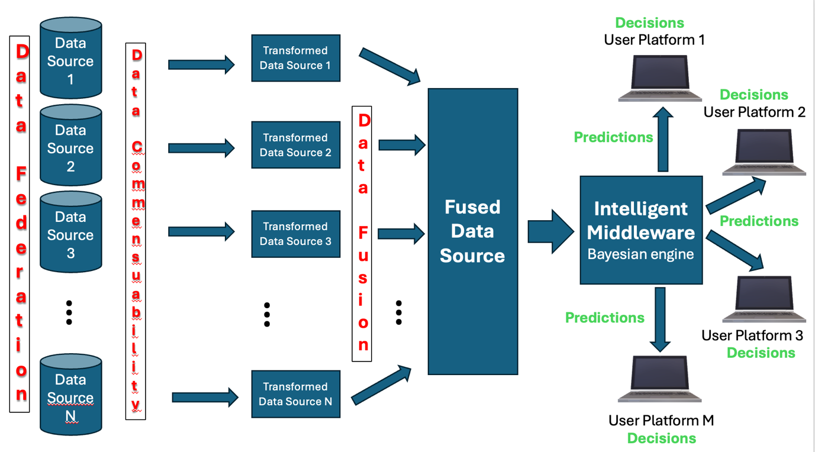
The CHILAM architecture
Research
Research
Research
“Minable View”
There are more than 45 databases, many publicly available, many from government and academic institutions - INEGI, SNIB, CONEVAL, DGE, Sec. Health., WorldClim,…. chilam.c3.unam.mx
Research
Notes:
Example, INEGI, WorldClim, SIAP, Coneval, GBIF, SNIB, muchos datos propios,… Commensurability. Data fusion. Problems with data sources. How we do science. Easier for spatio temporal where when data than who data.

Slide 14
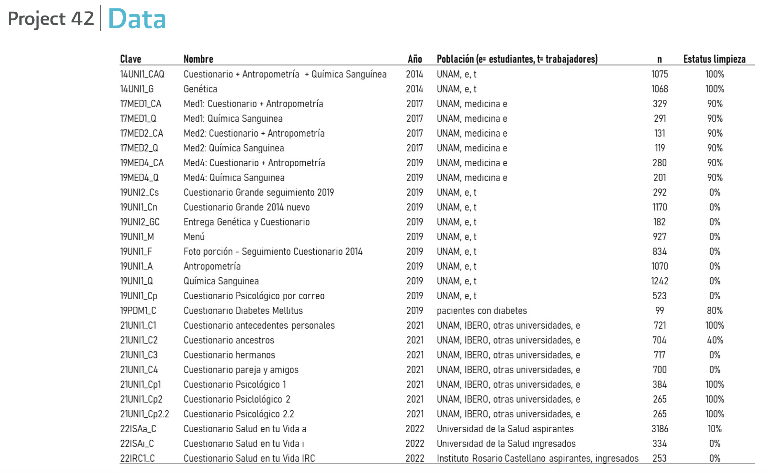
chilam.c3.unam.mx

Slide 15
An Example and its Challenges
1076 workers, academics and students of the UNAM collected in 2014
Prediction model for C = BMI > 29.9 = obesity
Total features # p < 0.05 % significant
Personal data 80 16 20
Anthropometry 49 26 53
Family history 549 73 13
Personal history. 131 23 18
Laboratory results 44 11 25
Health self-evaluation 227 70 31
Health knowledge 294 30 10
Nutrition 220 23 10
Lifestyle 391 54 14
Genetics 1077 34 3
Total 3062 360 12
Notes:
Taxonomic classification of features - which category of features is most relevant. Different ways to categorise.

Slide 16
Conclusions
All the world’s major problems are CAS – multifactorial-multiscale-multidisciplinary-multiobjective and…
Our fault - caused by Decision Cycles based on “bad” predictions (there’s no such thing as global warming) or “good” predictions based on “bad” objectives (short-term pleasure versus long-term health)
Standard frameworks for CAS are descriptive rather than predictive
Bayesian classifiers P(C|X) offer a “universal” phenomenologically-based (data-based) approach to modelling CAS
  We have lots of Tycho Brahes, lots of would-be Newtons and not enough Keplers
  Features can be “configuration-type” (obese, cancerous, age, SNP, external locus of control, high ghrelin,…) or “behaviour-type” (exercises, smokes,…)
To apply the formalism sucessfully, we need
  “Deep”, commensurable data sets
  Explainable AI to analyse them
  Interdisciplinary groups using Human Intelligence to interpret (causality-actionability) and implement them
We also need to change the way we create and apply science –
Don’t hold your breath!

Slide 17
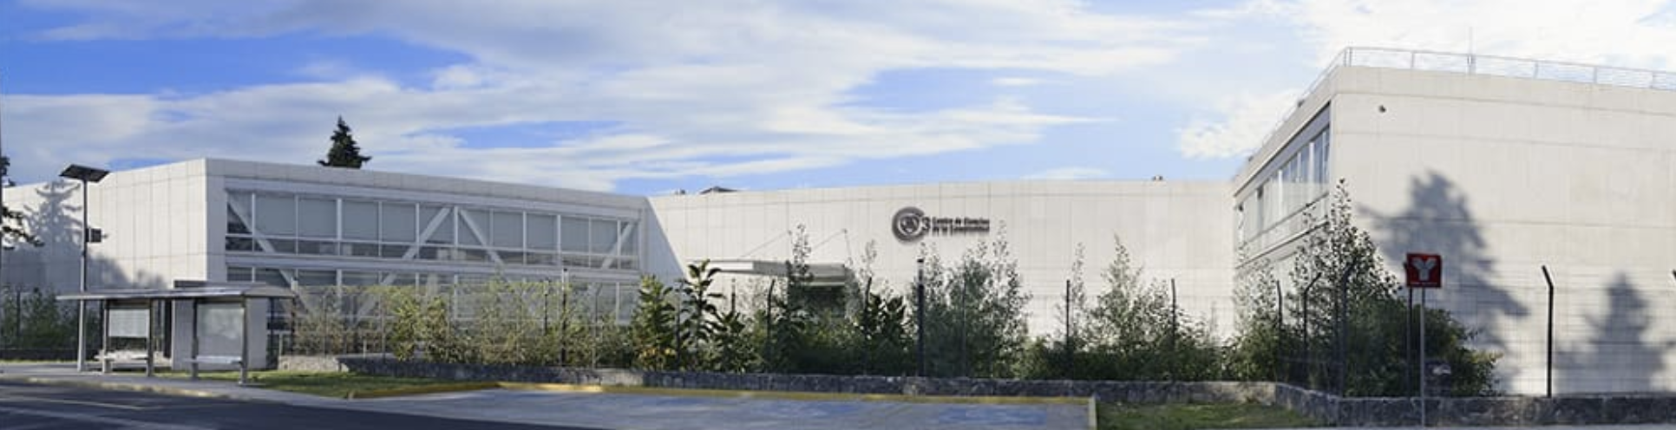
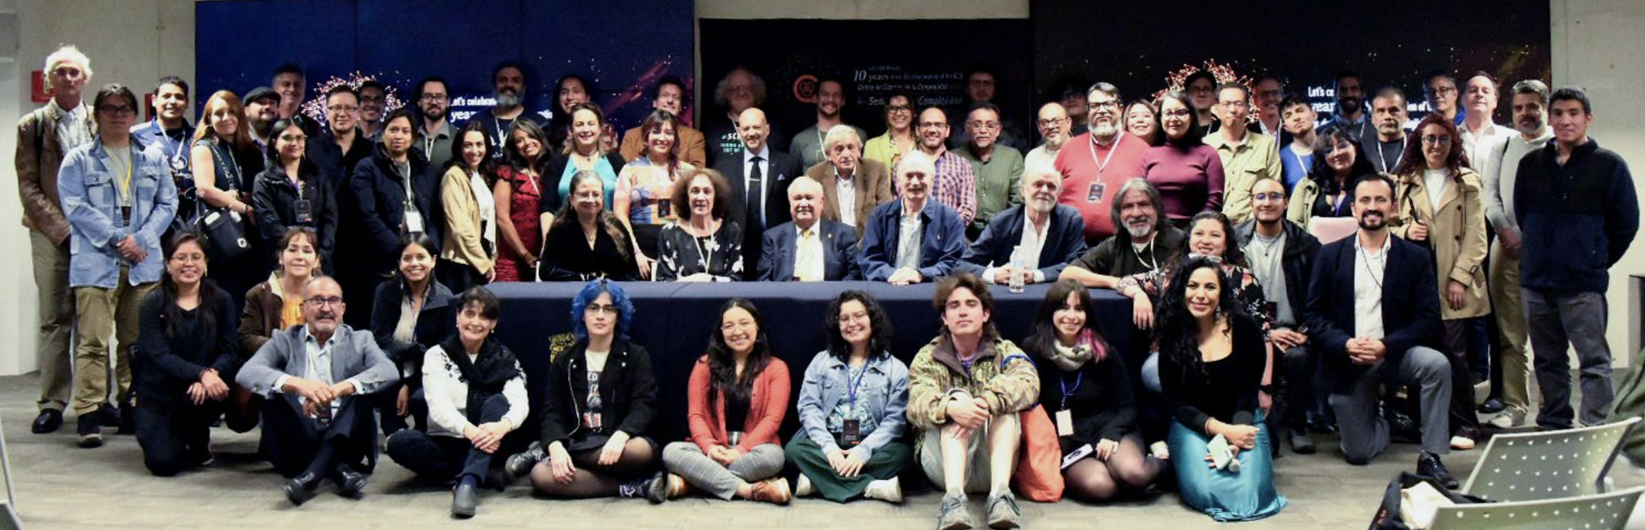
THANK YOU! COME VISIT!

Slide 18
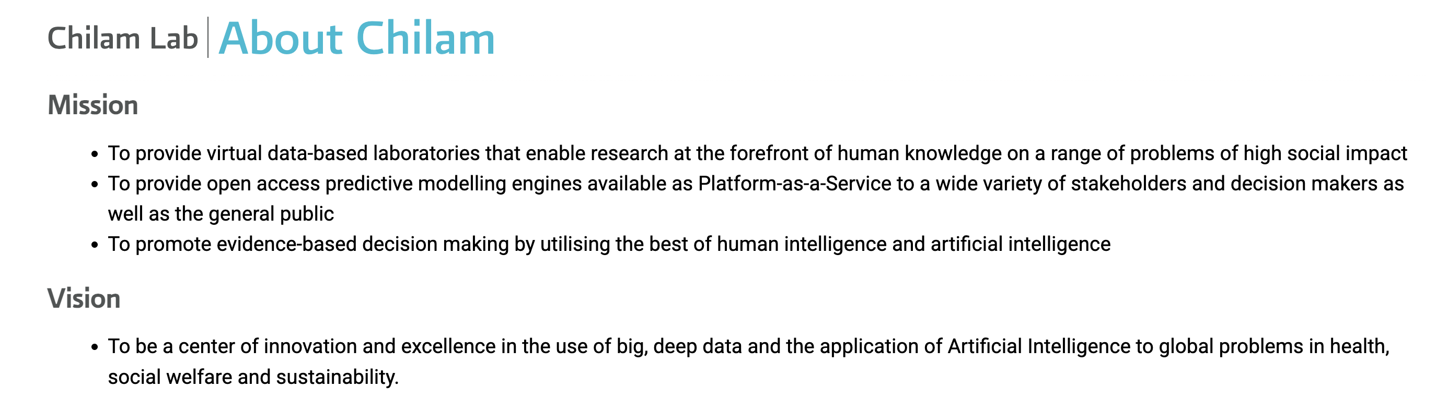






CHILAM: Laboratory for the Simulation of Complex Adaptive Systems
chilam.c3.unam.mx
Interdisciplinary
teams
Funding
Notes:
There are no decisions without predictions. But, do you want to explain – BB versus white box

Slide 19
Although there is a broad consensus as to many of the properties that are descriptive of Complex Adaptive Systems (CAS), there is no such consensus on what, if any, is an appropriate, general mathematical framework for predicting and explaining CAS. Here, we will show that Bayesian classifiers of the form P(C|X), where C is a class of interest and X is an arbitrary, multimodal vector of features, offers such a framework. C can represent any property of a CAS, be it a state, such as presence/absence of disease, or an update rule/behaviour, such as overeating or sedentariness. The high degree of multifactoriality/multicausality inherent in CAS manifests itself in the high dimensionality of X, with the consequence that statistical/machine learning algorithms are the most appropriate algorithmic representations, while adaptation manifests itself in two forms: i) that, using Bayes theorem, P(C|X) —> P(C|X’,X) in the light of new information X’; ii) that P(C|X) can naturally represent different update rules/behaviours, C. In analogy with the concept of a fitness landscape, P(C|X) represents a “Predictability Landscape”, where different models represent different approximations to the underlying landscape. In the case, where C represents a behaviour/conduct, in analogy with an omics perspective from bioinformatics, the set of variables X that predict the behaviour/conduct we will term the CONDUCTOME. Using several bespoke data sets associated with Project42 in the CHILAM lab (chilam.c3.unam.mx) we will show, using concrete examples from obesity and metabolic disease, how approximations to the CONDUCTOME can be constructed incorporating genetic, physiological, sociological, psychological, environmental and epidemiological data in a way where the relative contributions of each variable and variable class can be fairly assessed and compared. We will discuss the consequences for science and policy making.

Slide 20
chilam.c3.unam.mx
SPECIES (Niche and community ecological analysis) https://species.conabio.gob.mx/
EpI-SPECIES (10 emerging/neglected diseases) https://epispecies.c3.unam.mx/
EpI-PUMA (COVID19) https://covid19.c3.unam.mx/ and https://epipuma20.c3.unam.mx/
Project42 (obesity and metabolic disease) https://project42.c3.unam.mx/
Dyana (General purpose platform) https://dyana.c3.unam.mx
Notes:
Emphasise bringing machine learning to the domain experts who are not experts in ML/AI

Slide 21
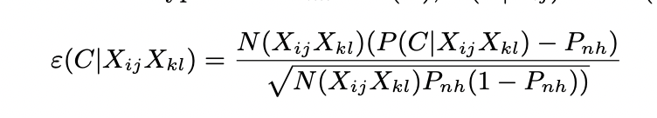
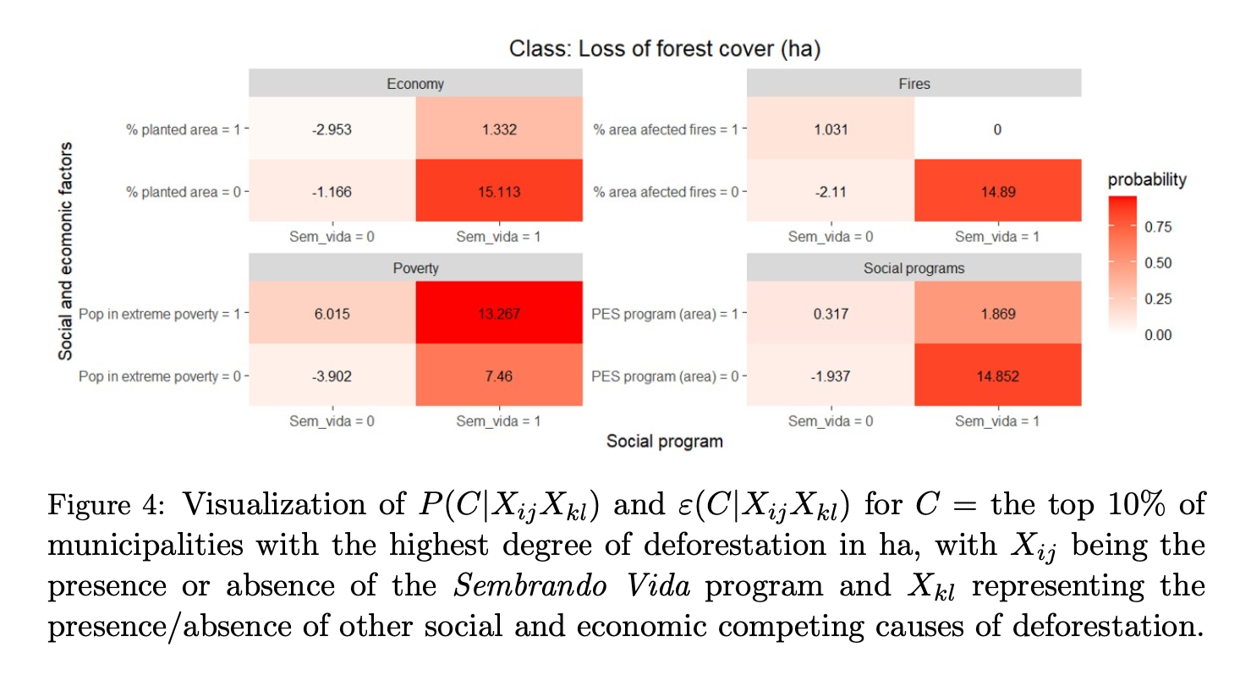
Causality
Bradford Hill 1965
The bigger the score the more likely that it is causal
For two potential causes represented as binary variables we have:
P(C|11), P(C|10), P(C|01), P(C|00)
“AB testing” – look for where cause 1 is present without cause 2, and vice versa, where they´re both present (to look for “epistasis”) and where they´re both absent (to look for other causes)
This will tell us whether the associations are statistically significant
Notes:
Challenge of micro versus macro causality

