Slide 1




SynEdu: An Open Teaching Platform for Reaction Modeling
Tieu-Long Phan
Winterseminar - Bled - 11.02.2025
Founded by the European Union
This project has received funding from the European Unions Horizon 2021 research and innovation programme under the Marie-Skłodowska-Curie grant agreement No 101072930

Slide 2






  OUTLINE
  Method
  Discussion
Motivation
  Result

Slide 3
01
Motivation

Slide 4


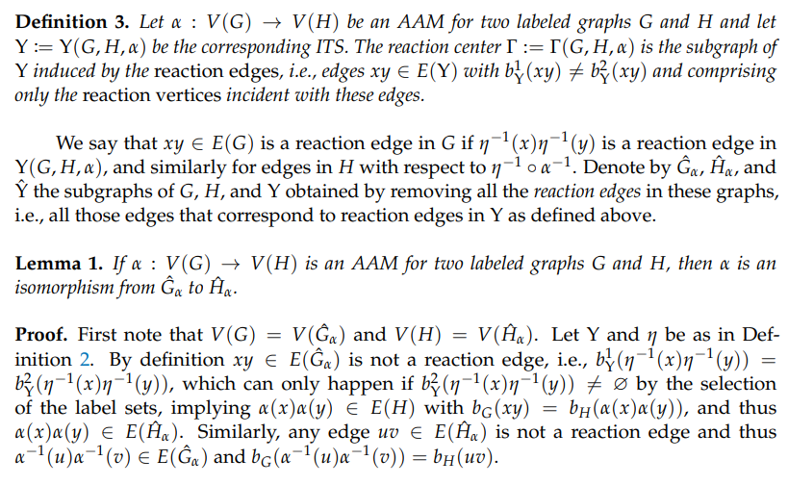
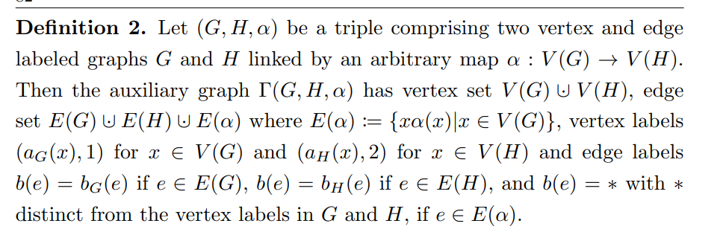

  Motivation
Chemical graph theory
González Laffitte (2024). Partial imaginary transition state (ITS) graphs: A formal framework for research and analysis of atom-to-atom maps of unbalanced
chemical reactions and their completions. Symmetry, 16(9), 1217.

Slide 5
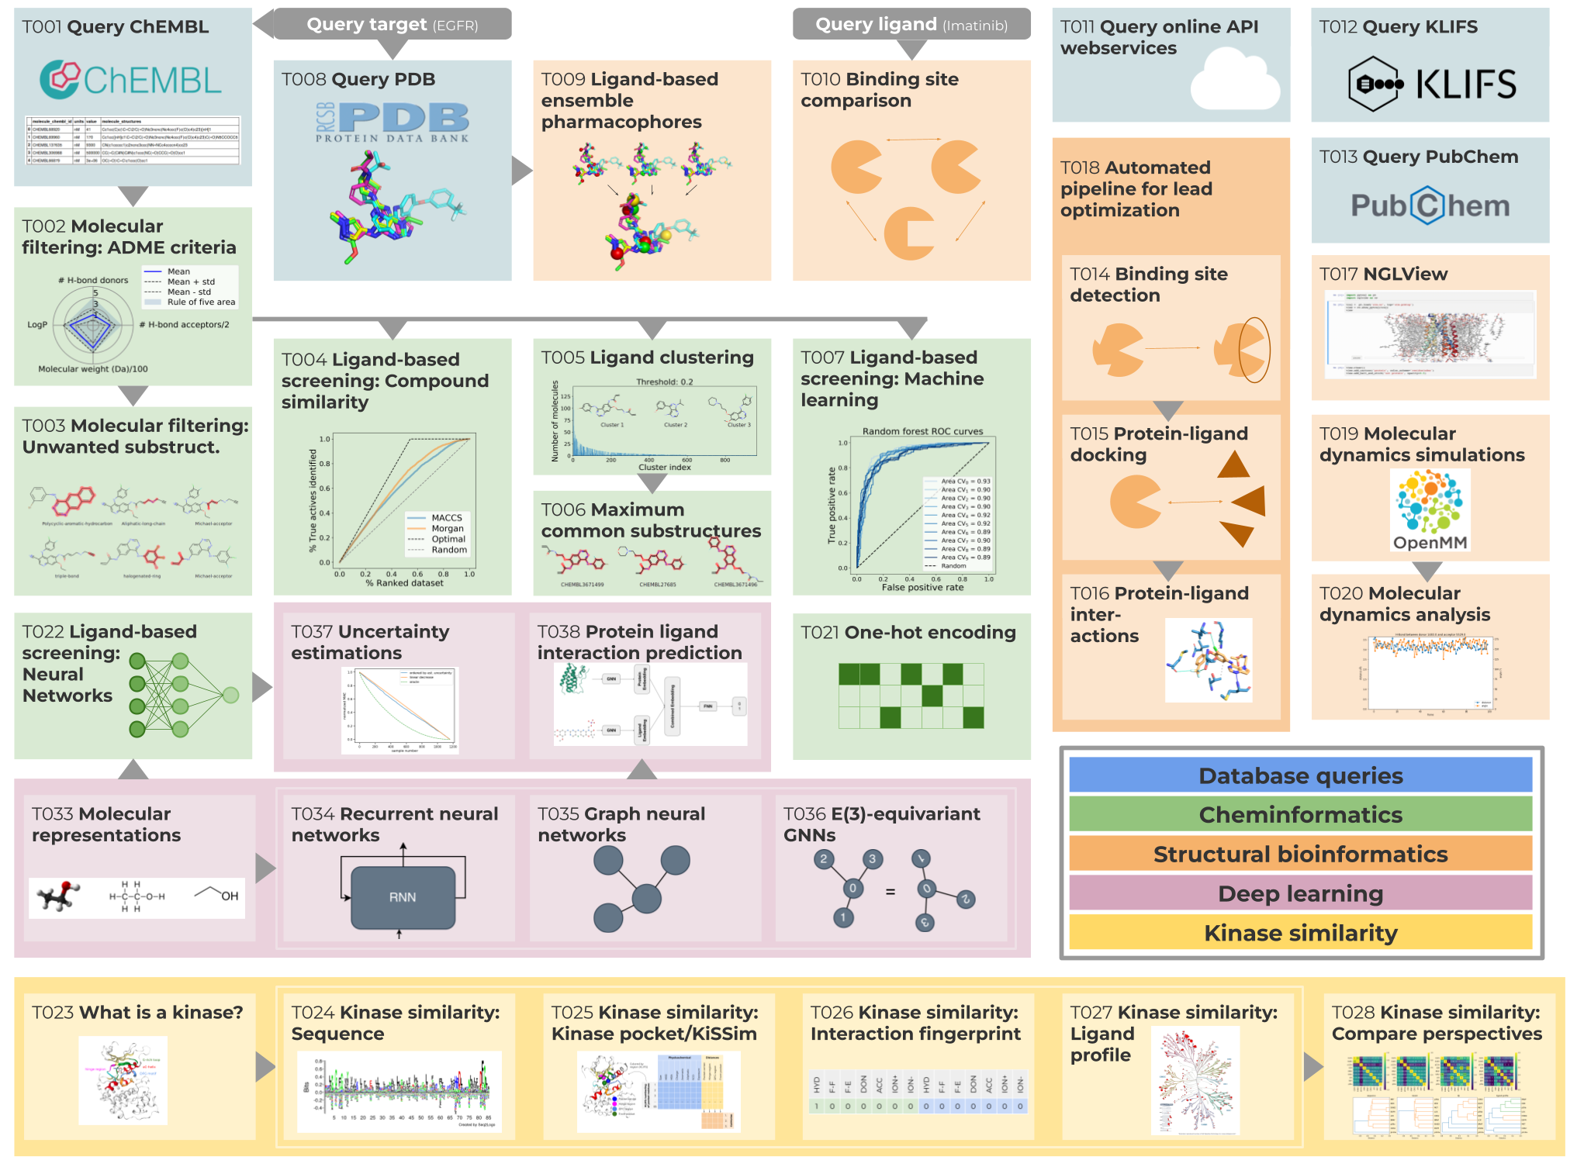
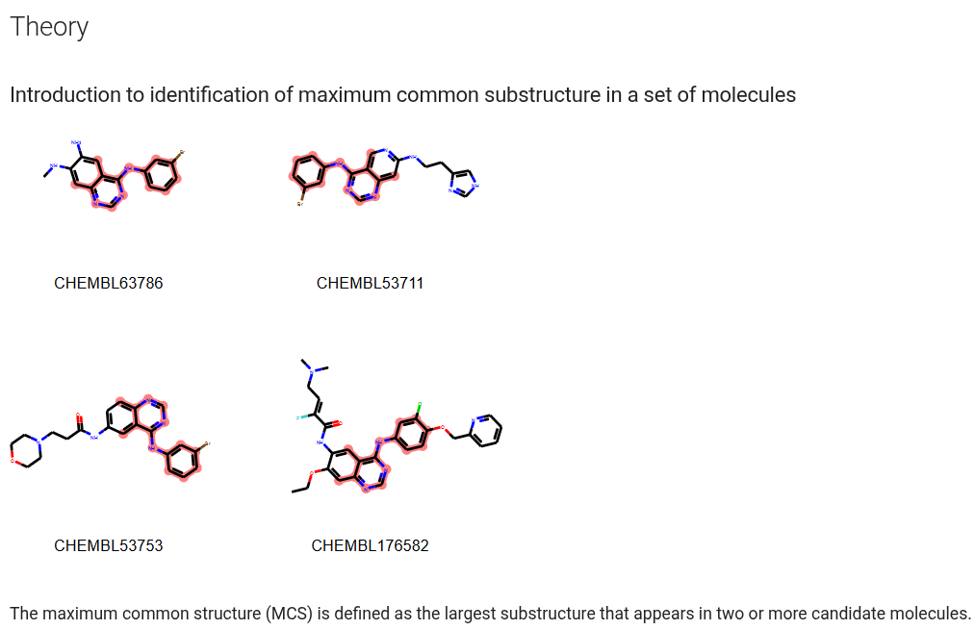
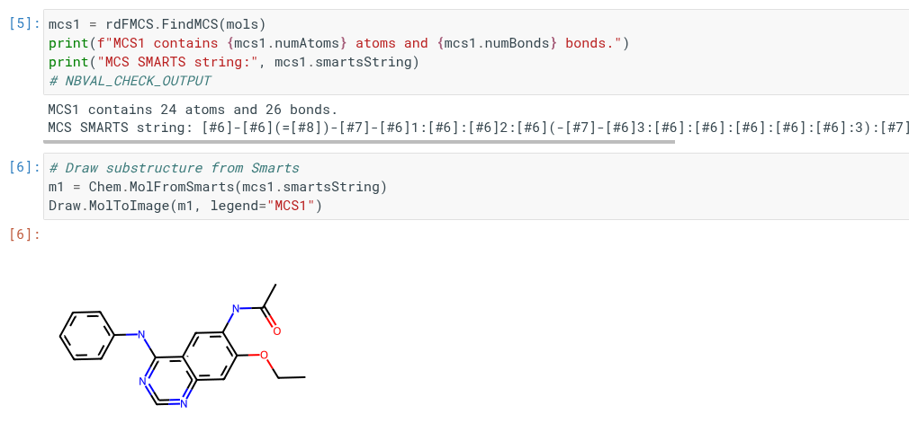
  Motivation
TeachOpenCADD
Sydow, D., Morger, A., Driller, M., & Volkamer, A. (2019). TeachOpenCADD: a teaching platform for computer-aided drug design using open source packages and data.
Journal of cheminformatics, 11(1), 29.

Slide 6
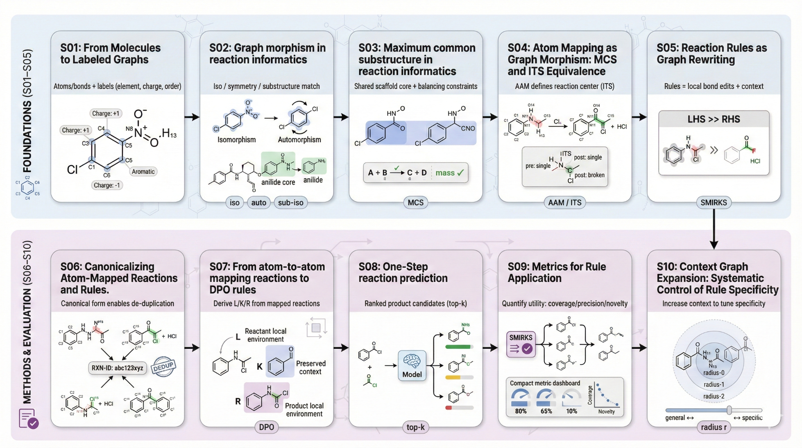
  Motivation
SynEdu

Slide 7
02
METHOD

Slide 8

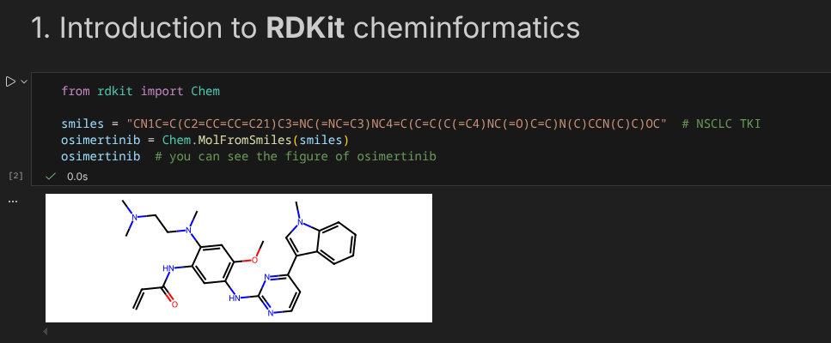
  METHOD
Jupyter notebook
Team, J. (2015). Jupyter notebook. Jupyter Notebook introduction,(Pristupito: 19.9. 2021) https://jupyter-notebook. readthedocs. io/en/stable/notebook. html.
Notes:
categorical theory

Slide 9
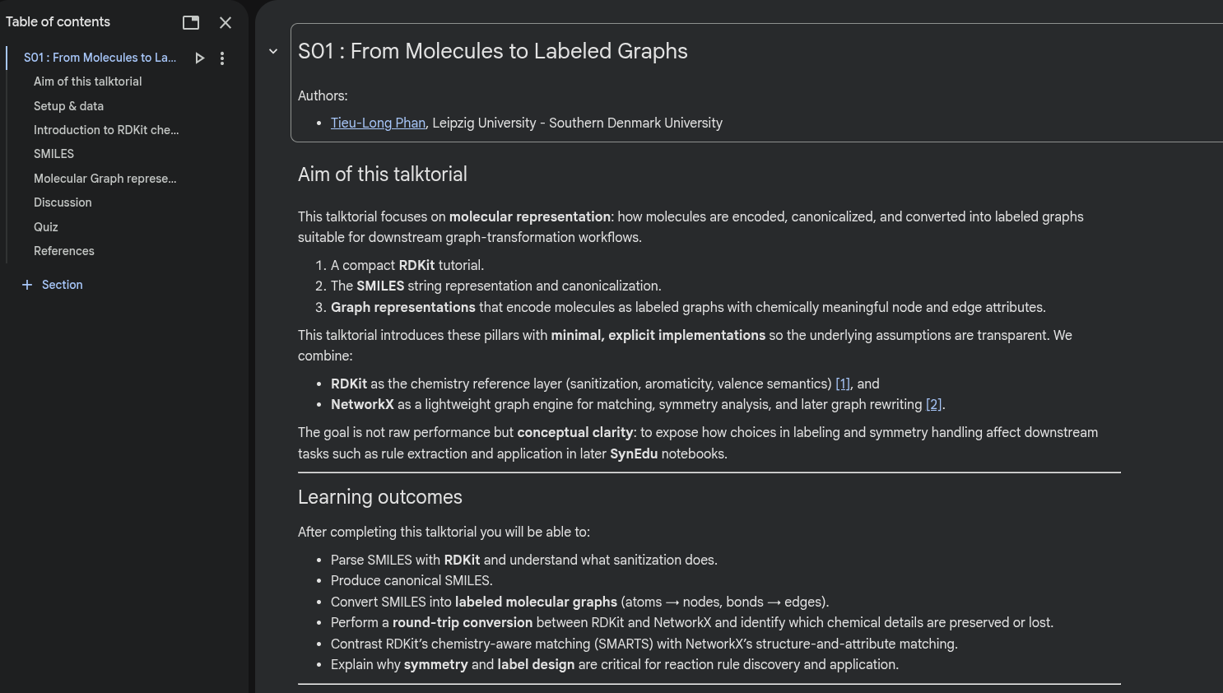
  METHOD
Google Colab
Bisong, E. (2019). Google colaboratory. In Building machine learning and deep learning models on google cloud platform:
a comprehensive guide for beginners (pp. 59-64). Berkeley, CA: Apress.
Notes:
categorical theory

Slide 10
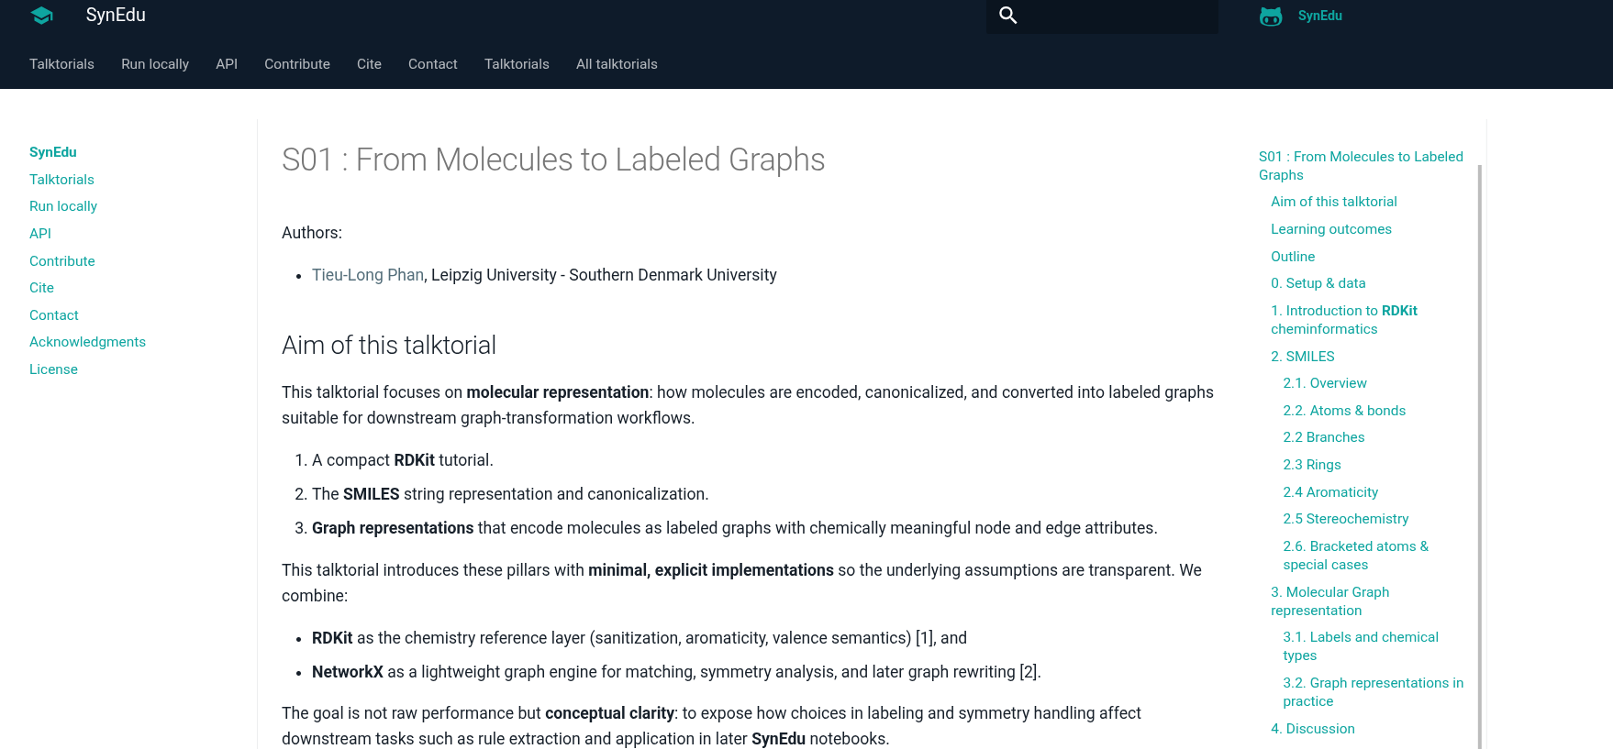
  METHOD
Webpage
Notes:
categorical theory

Slide 11
03
RESULT

Slide 12
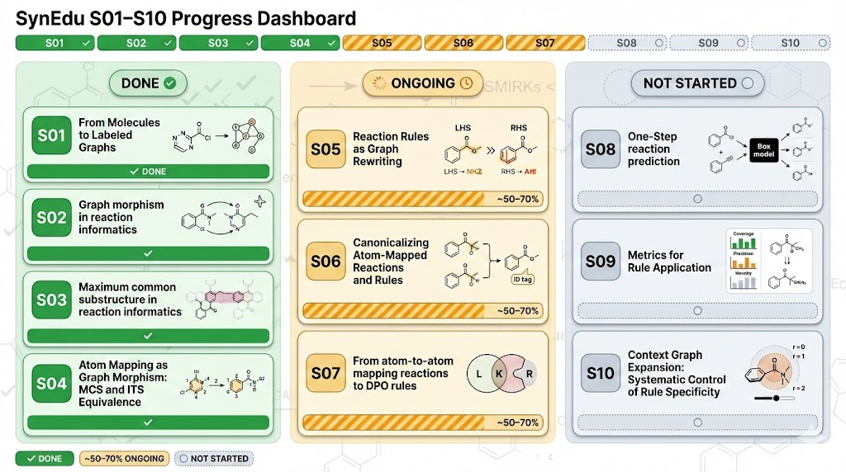
  RESULT
Progress

Slide 13
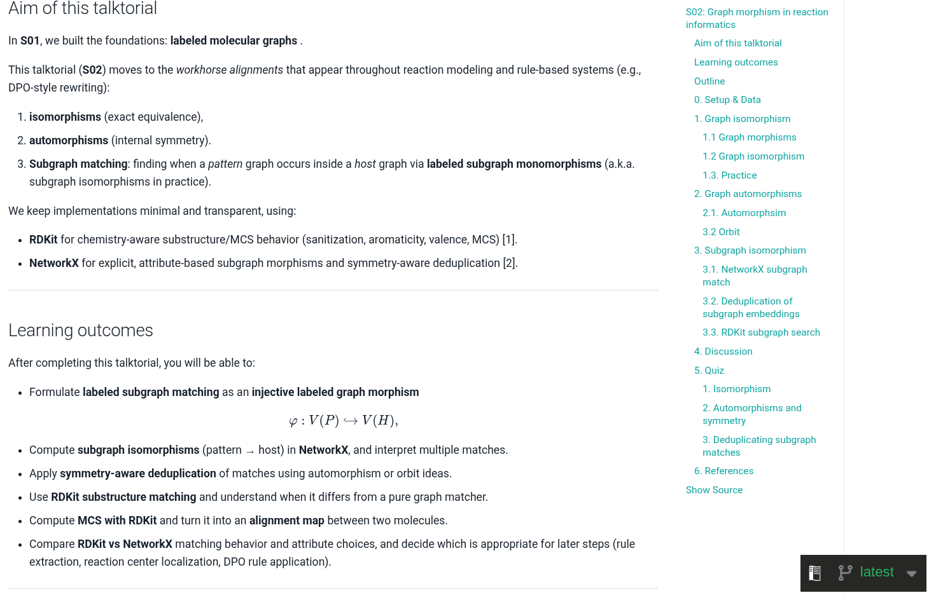
  RESULT
Example

Slide 14
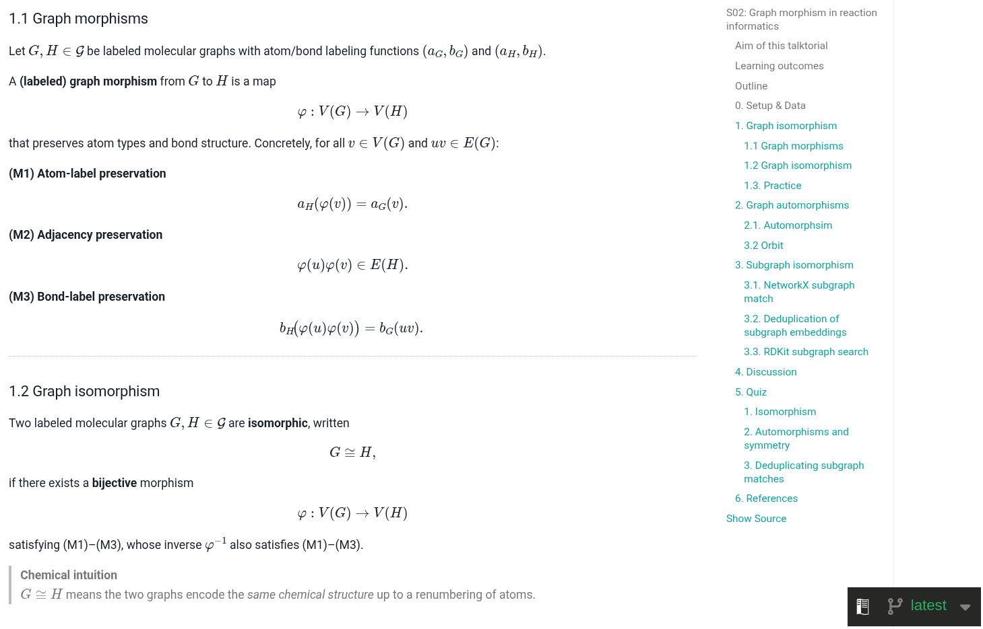
  RESULT
Example

Slide 15
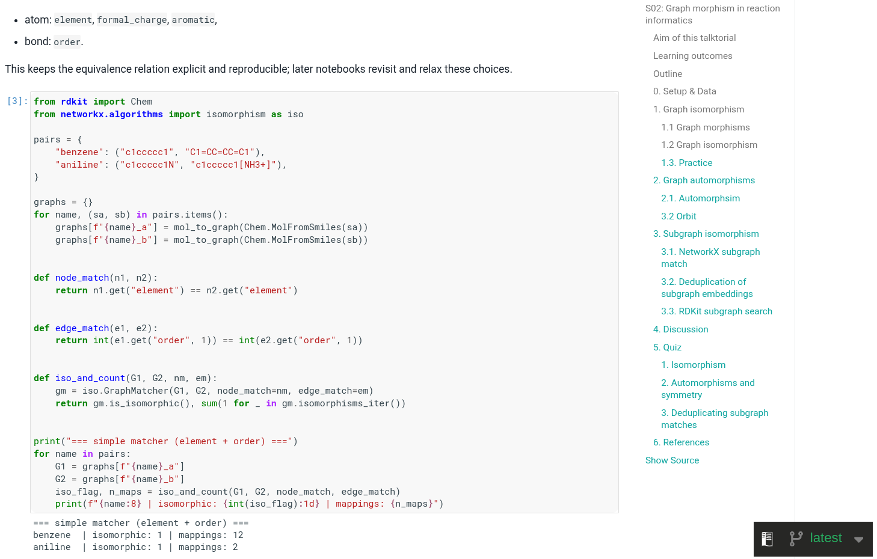
  RESULT
Example

Slide 16
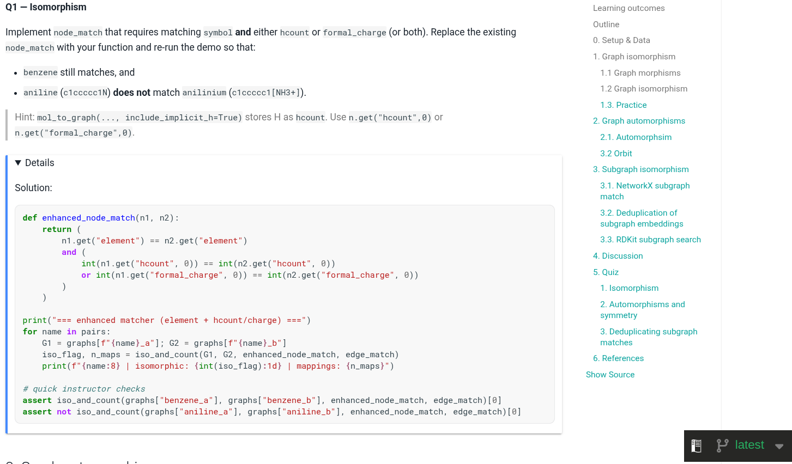
  RESULT
Example

Slide 17
04
DISCUSSION

Slide 18

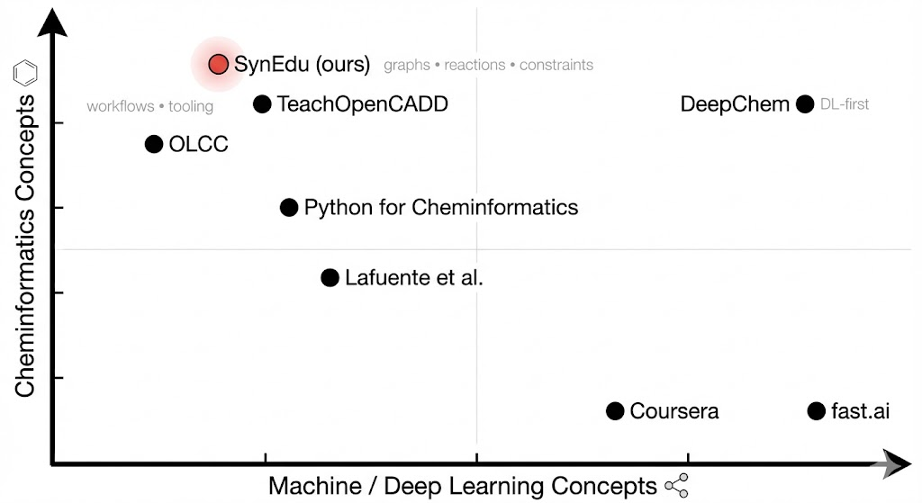
  DISCUSSION
Scope
Notes:
Targets (six out of eight described in our Chem paper) synthesized according to Chematica’s plans and MilliporeSigma’s performance metrics for the syntheses performed. *This entire route is now chromatography free, **this route was also used on new related analogs with great success, and ***significant cost savings are anticipated in the production batch.

Slide 19

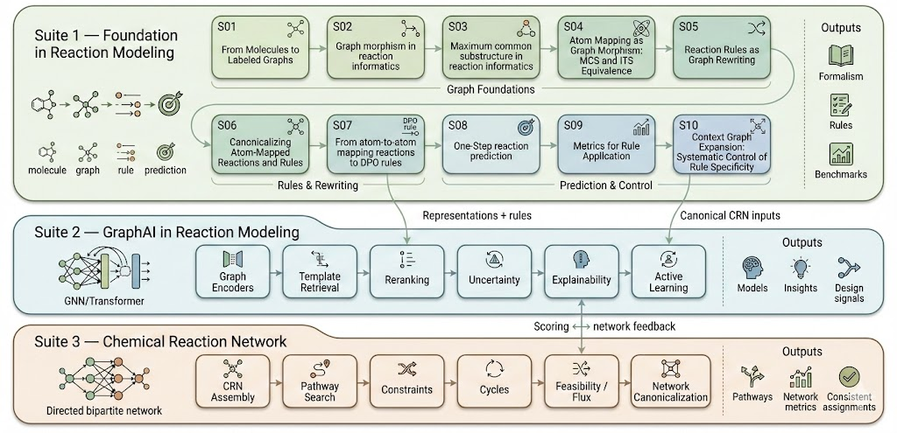

  DISCUSSION
Outlook

Slide 20
Thank you for your attention
Founded by the European Union
This project has received funding from the European Unions Horizon 2021 research and innovation programme under the Marie-Skłodowska-Curie grant agreement No 101072930

Slide 21

