Slide 1



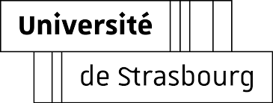





Project Report
SynART: Attention-Guided Reaction-Center Design for Template-Free Synthesis
Thanh-An Pham
09/02/2025

Slide 2




EDUCATION
RESEARCH INTERESTS
Master 2 of ChEMoinformatic+ Erasmus Mundus Program:
  University of Strasbourg
  NOVA FCT
Bachelor of Pharmacy
  University of Medicine and Pharmacy at Ho Chi Minh City, Vietnam
  Cheminformatics
  Advanced Machine Learning for Innovative Drug Discovery (AIDD)
  Drug Discovery – Identification and Optimization of lead compounds
  Synthesis planning
  Synthesis of biologically active molecules
Thanh-An Pham
Vietnam
ptayds2001@gmail.com
PROFESSIONAL SKILLS
https://github.com/Thanh-An-Pham
  Programming Languages: Python
  Cheminformatics: RDKit, DeepChem, Pymol, Openbabel
  Molecule modelling: Molecular docking, Molecular dynamics, ChimeraX
  Machine learning/Deep learning: Scikit-learn, Pytorch, Pytorch Geometry, Optuna.
1
Notes:
Good Afternoon , Sir, I am Thanh-An Pham. Thank you for giving an oppoturnity to interview with you.
I am now an undergraduate at Univeristy of Med and Phar at HCM, in. My major is Pharmacy. I have research interest in Computer-Aided Drug Design and organic synthesis method in drug discovery.
I had 3 year experience in applying in-silico method in drug discovery and 1 year in synthesis org chem as research asistant at Department of Organic chemistry.
During this time, I feel a strongly connection to the academic environment, so I decide to pursues for Master degree. And the Cheminfomatics program stand out as a prestigious master program that to obtain a solid foundation of knowledge in this field, which will secure for my PhD career.
Moreover, the mutual exchange and financial support will help me get along with the international academic.
These are my professional skills, which are the intersection of Chemistry, Computer Science.
2

Slide 3




CONTENTS
01
02
Background
Architecture
03
04
Result
Future Work
2

Slide 4
01
Background
3

Slide 5


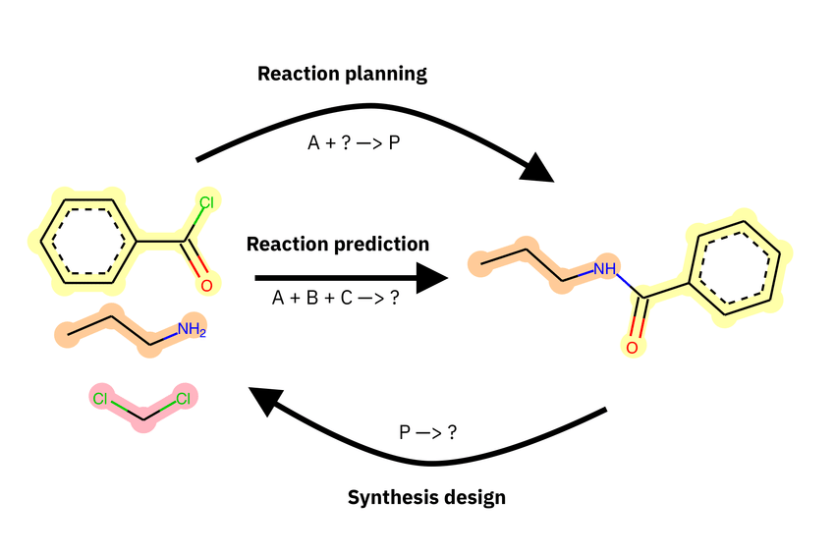
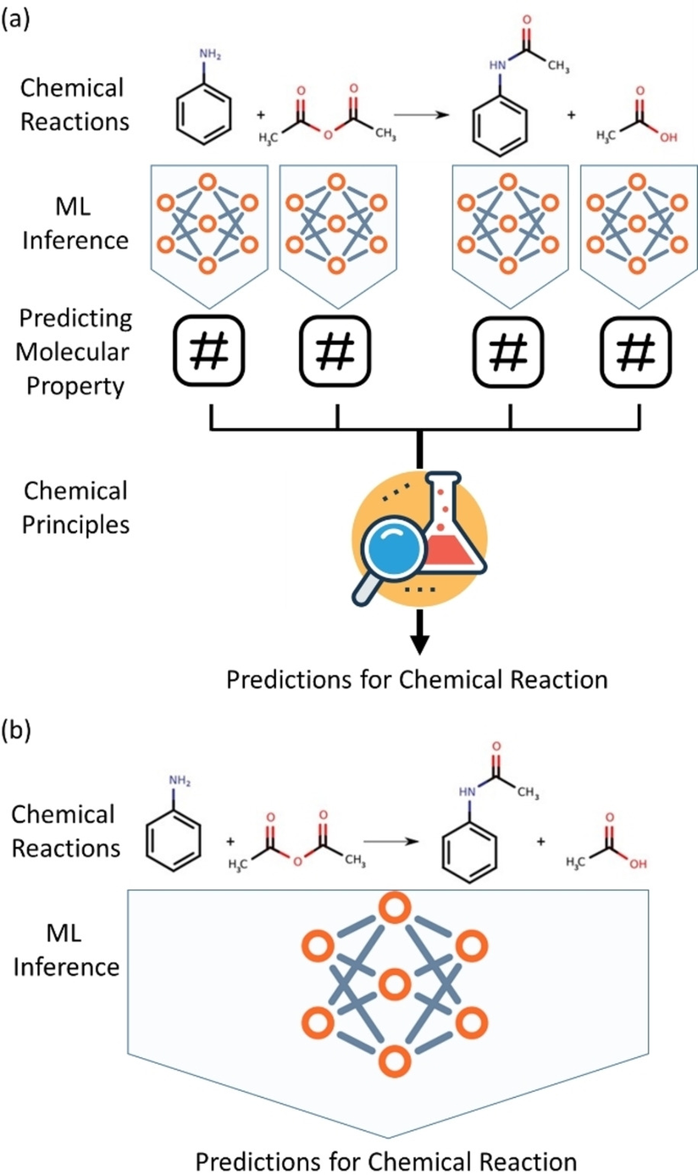
Background
Architecture
Results
Future Works
Background
Griffiths, R. R., et al. (2021). Dataset bias in the natural sciences: a case study in chemical reaction prediction and synthesis design. arXiv preprint arXiv:2105.02637.
4
Notes:
in reaction planning, you might be told only A and desired P and must infer the missing “?”,
in reaction prediction, you’d be told everything in the pot and predict the product,
in synthesis design, you start from P and infer what could make it.
But for all three tasks implicitly depend on the reaction center.

Slide 6
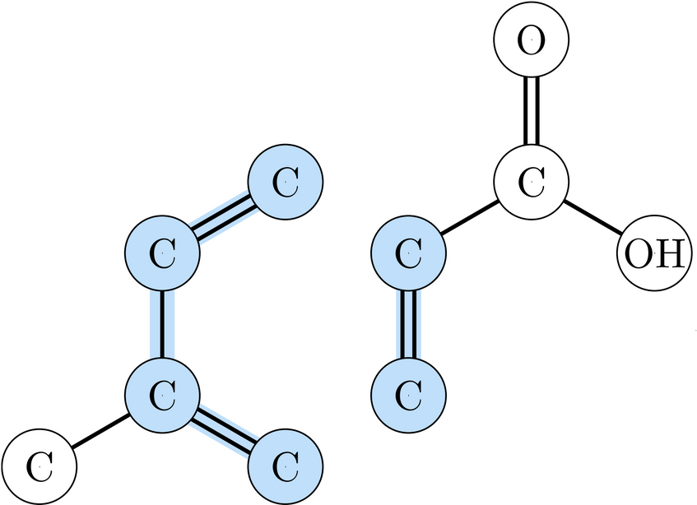
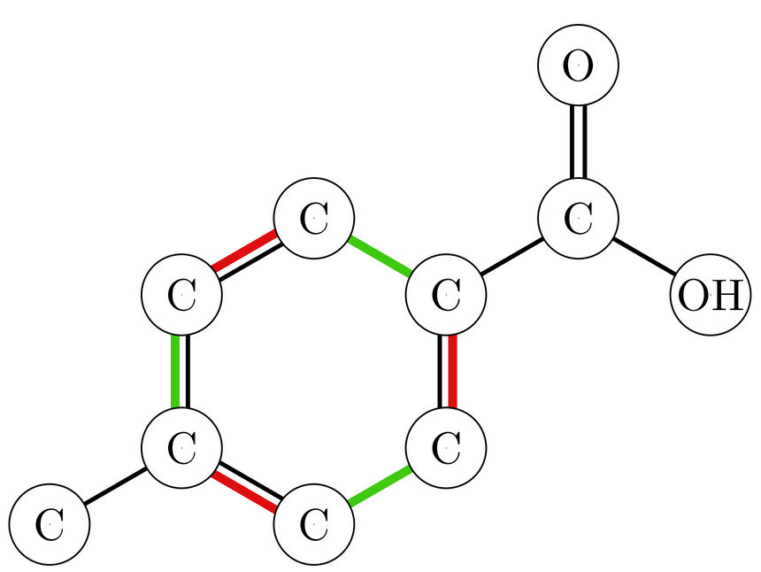
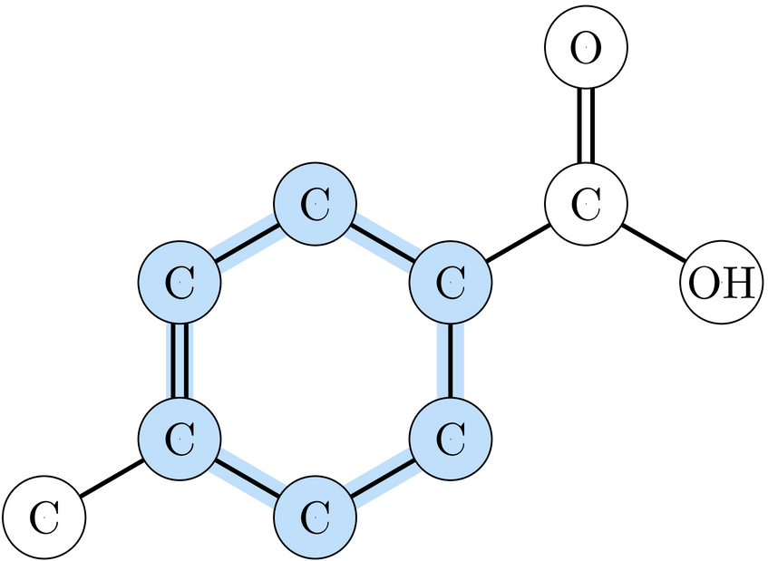
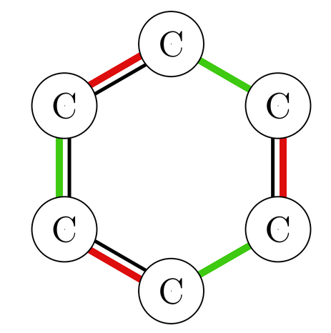
Background
Architecture
Results
Future Works
Objective
ITS
Predict Reaction Center
Backward Tasks
Foward Tasks
5

Slide 7
02
Architecture
6

Slide 8
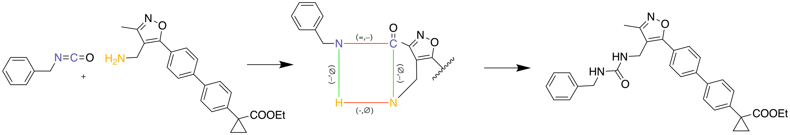
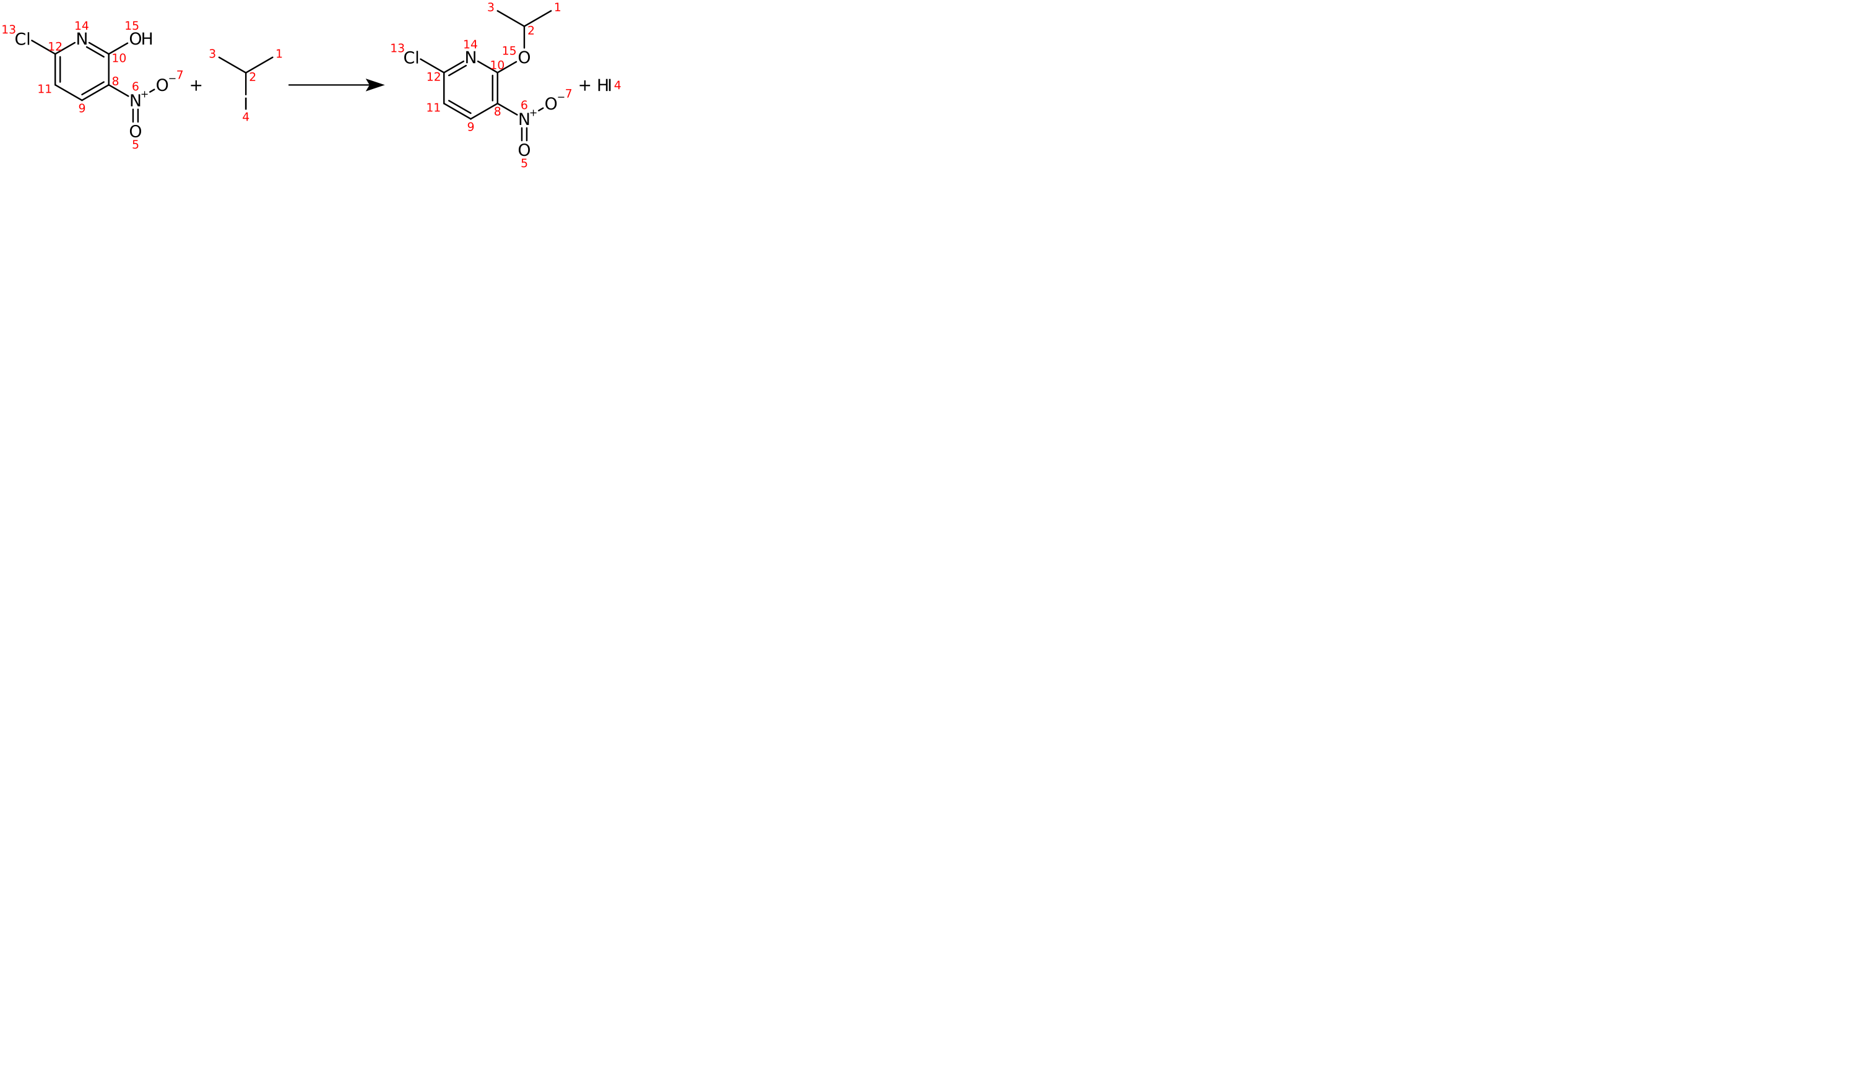

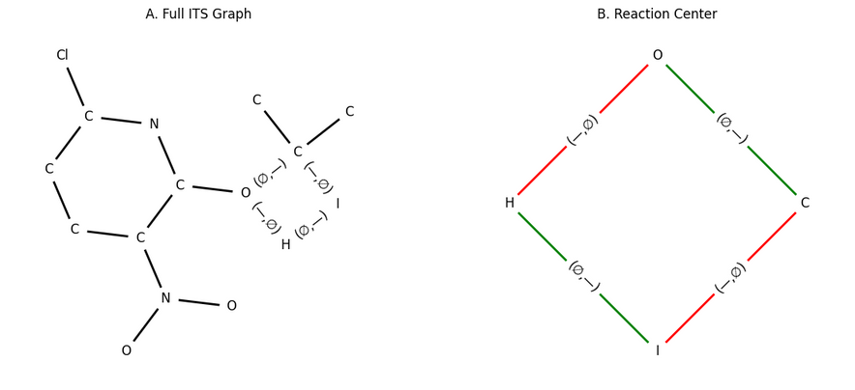
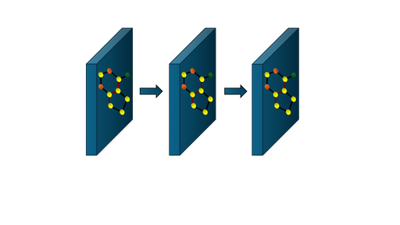








Background
Architecture
Results
Future Works
1.GRAPH ENCODER
4.REACTION RECONSTRUCTION
Reaction Center
Success / Fail
OUTPUT
INPUT
FEATURE ENCODING
DMPNN + GINE
15
Inter Bond
not exist at first
.
.
.
.
.
.
.
.
.
.
.
.
.
.
Hierachical Reaction Center Reconstruction
16
2
3.REACTON CENTER PREDICTIONS
Graph Embeddings
No initial bond feature
P(Atom ∈ RC)
#Atom in RC
P(Bond ∈ RC)
7-Class Prediction
#Bond in RC
4
2. SELF-ATTENTION
R
V
Q
K
Atom Mask
Atom Count
Bond Mask
Bond Change
Bond Count
SOFTMAX
A
Reactant Vectors
7
7
CHEMICAL BIAS
Notes:
Quantunm numbers, outer shell e, formal chảge, total H, hybridization, lone pair , neighobur count
Bond type, conjugation.

Slide 9
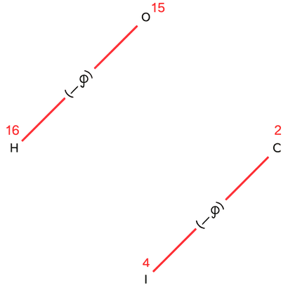
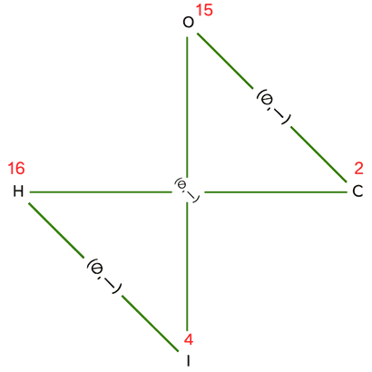
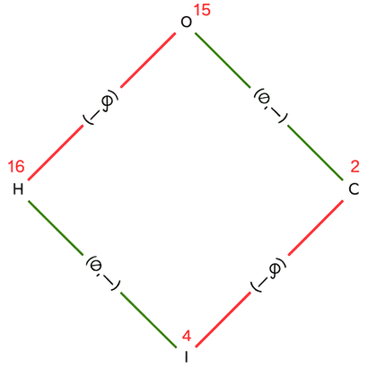
Background
Architecture
Results
Future Works
Bond-centric approach
4.REACTION RECONSTRUCTION
Reaction Center
Success / Fail
1. SELF-ATTENTION
OUTPUT
2. BOND TRANSFORMER
3.REACTON CENTER PREDICTIONS
CANDIDATES
GREEDY CHEMICAL
SELECTION
  Valence, Octet Rule
  Chemistry Scoring
  Electronegativity Pattern
Probability
(Intra Bond
∈ RC)
Intra Bond Change in RC
INTRA BOND MASK
INTRA BOND CHANGE
ENUMERATE CANDIDATE NEW INTERMOLECULAR BONDS
Break Bond in RC + Bond change Magnitude
7
8
Notes:
Quantunm numbers, outer shell e, formal chảge, total H, hybridization, lone pair , neighobur count
Bond type, conjugation.

Slide 10
03
Results
9

Slide 11
Background
Architecture
Results
Future Works
Results
USPTO50K
Atom centric Architecture | Atom centric Architecture | Atom centric Architecture | Atom centric Architecture | Bond-centric Architecture | Bond-centric Architecture | Bond-centric Architecture
 | Exact atom set | Exact membership | Exact RC | Exact breaked bond set | Exact breaked + Δ bond set | Exact RC
Train (27514) | 26223/27514 (95.31%) | 20417/27514 (74.21%) | 18129/27514 (65.89%) | 24289/27514 (88.28%) | 24185/27514 (87.90%) | 14255/27514 (51.81%)
Valid (3439) | 3215/3439 (93.49%) | 2497/3439 (72.61%) | 2213/3439 (64.35%) | 3006/3439 (87.41%) | 2984/3439 (86.77%) | 1778/3939 (51.70%)
Test (3440) | 3206/3440 (93.20%) | 2517/3440 (73.17%) | 2254/3440 (65.52%) | 3039/3440 (88.34%) | 3022/3440 (87.85%) | 1822/3440 (53.26%)
10

Slide 12
04
Future Work
11

Slide 13
Background
Architecture
Results
Future Works
Future Work
Interpolate Bond Forming
MEDIUM / HARD Splitting
Other Datasets
Benchmarking
Finalize the basis chemical rules for selection
Scaffold splitting to ensure Extrapolate ability of model
=> Template free objective
  UPSTO-FULL
  Reaxys
  ORD
  ILP ??
  Atom and Bond never seen during training
12
Notes:
Thuật toán phân mảnh được đề tài đặt tên là AP mô típ
Quá trình phân mảnh cấu trúc được so sánh với các phương pháp của BRICS và thuật toán ban đầu của HVAE

Slide 14

Thank you for your time !
Notes:
Tên tạp chí + tác giả + ngày, ko cần số doi

