Slide 1




Molecular design using learnable graph grammars
Aleksandra Olshanova
PhD student
Training Alliance for Computational Systems Chemistry (TACsy)
Supervisors:
Jakob Lykke Andersen,
Peter Dittrich,
Rolf Fagerberg,
Christoph Flamm,
Daniel Merkle.
2026

Slide 2

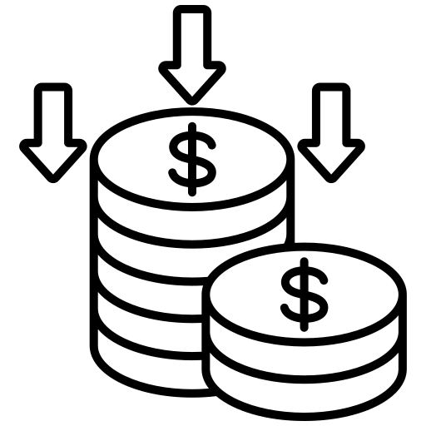
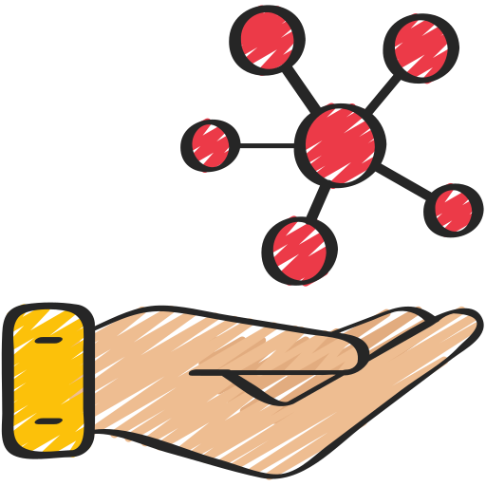



Why in silico molecule generation is important?
Drug discovery
Time
Reduced cost
Materials
Agrochemicals
Desired properties
Sustainability
Perfumes & Flavors

Slide 3
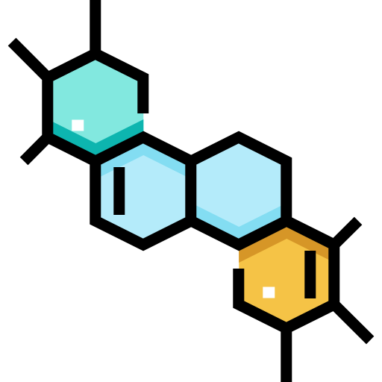
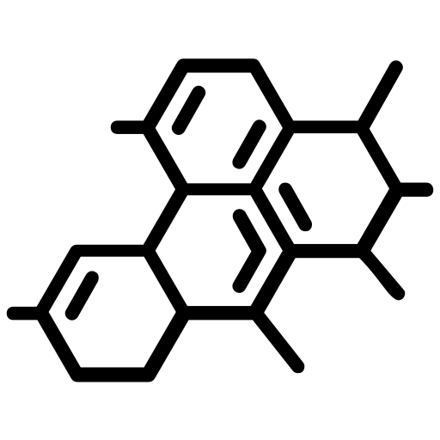

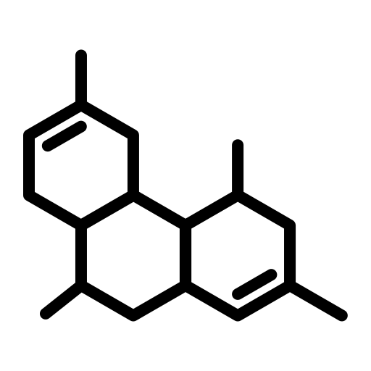
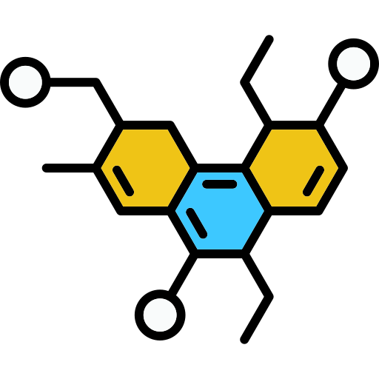
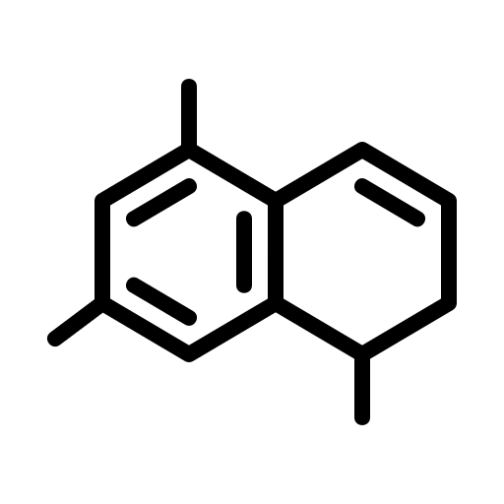
Current methods to generate new molecules
Generated set of molecules:
What methods do exist?
Domain-specific
dataset
Chemically valid
Unique (no duplicates)
New
Optimized property profile

Slide 4

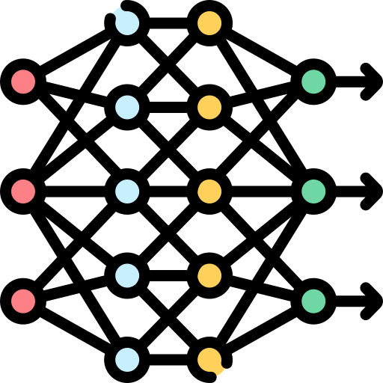

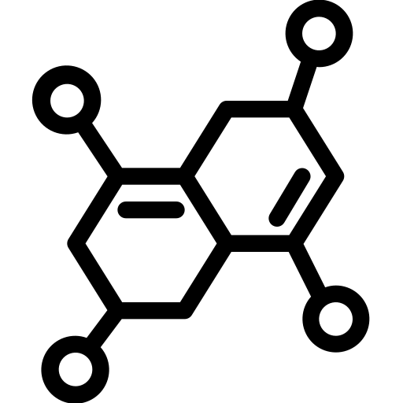
Current approaches to generate new molecules
Generated set of molecules:
Deep generative models
Domain-specific
dataset
Molecular representation
Generate
Optimize
SMILES
Neural networks (RNNs, VAEs, GANs)
Bayesian optimization
…
Graphs

Slide 5
Current approaches to generate new molecules
Generated set of molecules:
Deep generative models
Domain-specific
dataset
Molecular representation
Generate
Optimize
A lot of data
is needed.
Complex architectures and hard to interpret.
Invalid molecules: synthesizability issues.

Slide 6
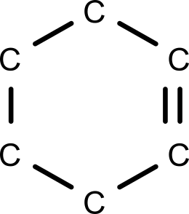
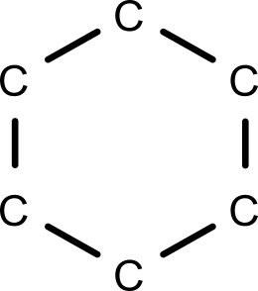

Idea
Graph
Graph
Grammar

Slide 7
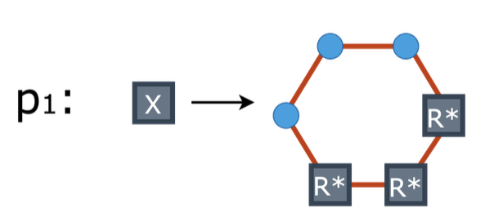
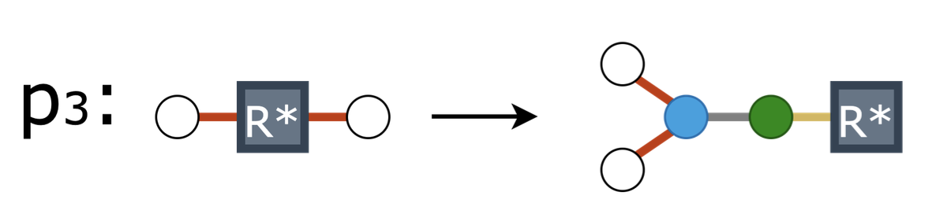
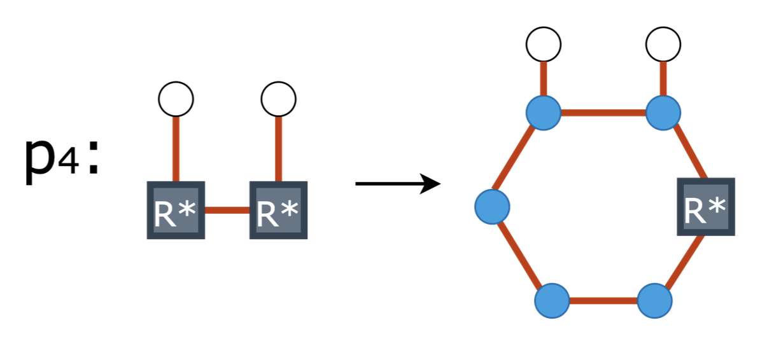
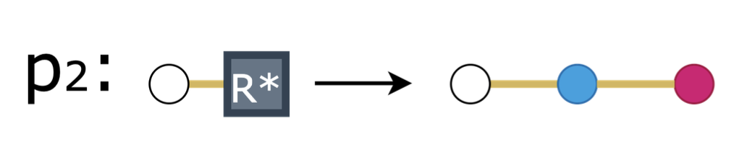
Project goal
Goal: Learning molecular graph grammar for generating diverse, chemically valid molecules with desired properties.
Graph grammar
Generated set of molecules:
Dataset
+
Domain-specific
properties

Slide 8



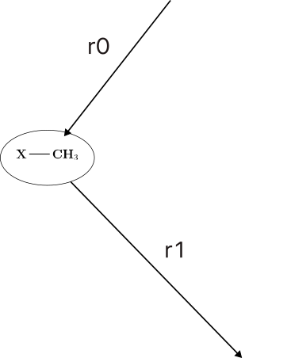
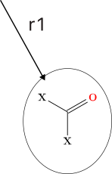
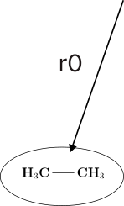
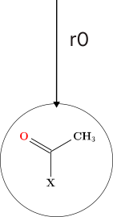
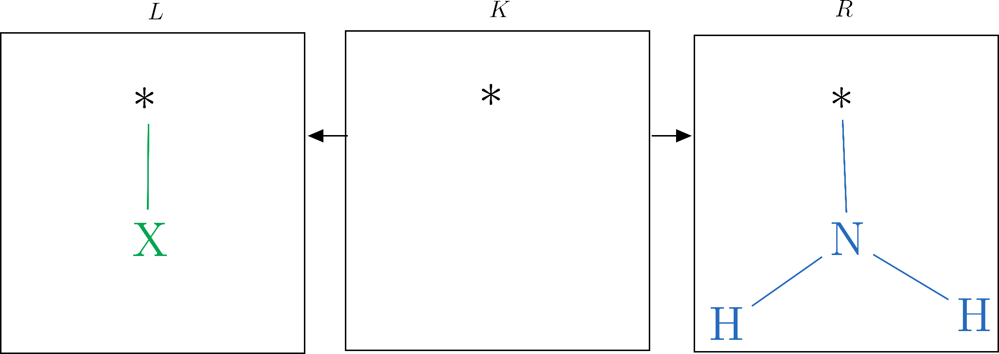
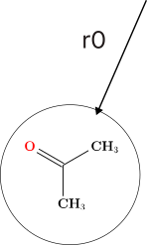
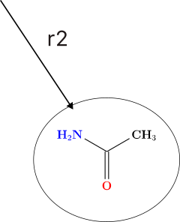
First part of the project
Example:
Goal:
Design a framework for automatically generating graph grammars by combining frequent subgraph mining with rule extraction.
N = {SSS , X} - Non-terminal nodes
∑ = {chemical atoms} - Terminal nodes
G =
P =
- Production rules
(r0, r1, r2, r3)
r3, r1, r0, r0
r3, r0, r1, r0
*MØD

Slide 9

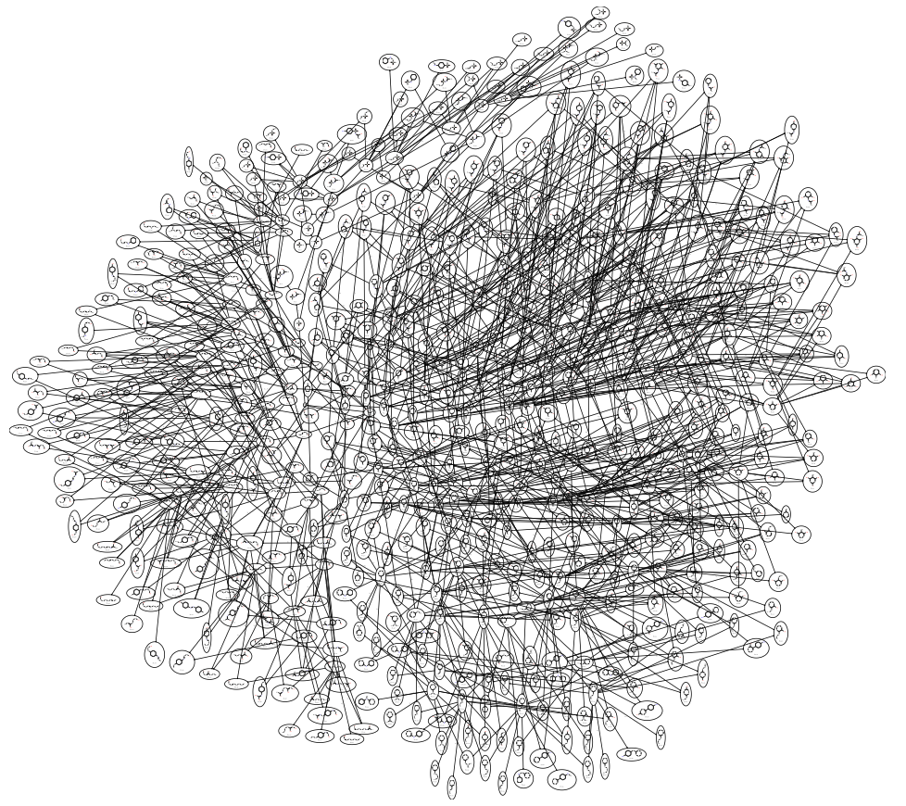


Second part of the project
Goal:
Design a learning algorithm to guide generation toward rule sequences resulting in molecules with desired properties.

Slide 10
Second part of the project
Goal:
Design a learning algorithm to guide generation toward rule sequences resulting in molecules with desired properties.
Generated molecules
Evaluation based on desired properties

Slide 11
Second part of the project
Goal:
Design a learning algorithm to guide generation toward rule sequences resulting in molecules with desired properties.
Generated molecules
Evaluation based on desired properties

Slide 12
Second part of the project
Goal:
Design a learning algorithm to guide generation toward rule sequences resulting in molecules with desired properties.
Which combination of rules from the entire graph grammar should we use to guide the generation process toward the desired chemical space?
Generated molecules

Slide 13
Markov chains approach
Graph grammar with rule probability weights
Sequence 1: r1, r2, r3
Sequence 2: r1, r2, r1
rule_1
Sequence 3: r2, r3, r2
⅓
1.0
rule_2
Previous | Next | Count | Probability
r2 | r3 | 2 | ⅔
⅔
1.0
r2 | r1 | 1 | ⅓
r1 | r2 | 2 | 1
r3 | r2 | 1 | 1
rule_3

Slide 14
Markov chains approach
Transition matrix
Transition probability matrix to predict future states
rule_1
 | r1 | r2 | r3
r1 | 0 | 1.0 | 0
r2 | ⅓ | 0 | ⅔
r3 | 0 | 1.0 | 0
⅓
1.0
rule_2
⅔
1.0
rule_3

Slide 15
Markov chains approach
Graph grammar with rule probability weights
Sequence’s weights,
score
Sequence 1: r1, r2, r3
5
2
1
Sequence 2: r1, r2, r1
Sequence 3: r2, r3, r2
Adjust transition probability weights to favor rule sequences producing molecules with desired properties.

Slide 16

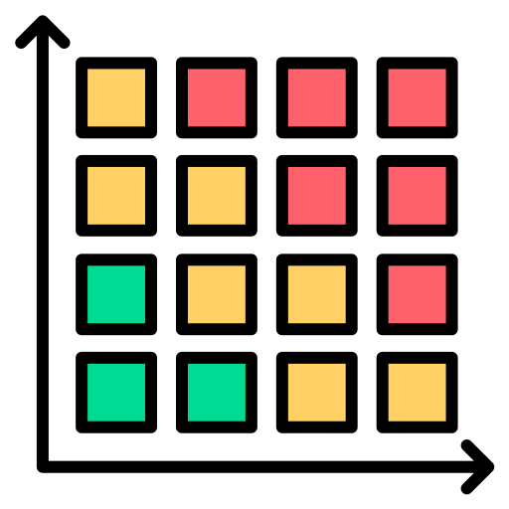

Learning
Sampling
Parameters:
Number of learning rounds,
Number of rule sequences for each round,
Depth of each sequence,
Target value,
Order (history-based),
A, B = weights for transition matrices,
pm_updated = A*pm +B*pm_i
Sequence 1: r1, r2, r3
Sequence 2: r1, r2, r1
…
Sequence n: r2, r3, r2
Initial transition
matrix, pm
Scoring
Update weights
New transition
matrix, pm_i

Slide 17
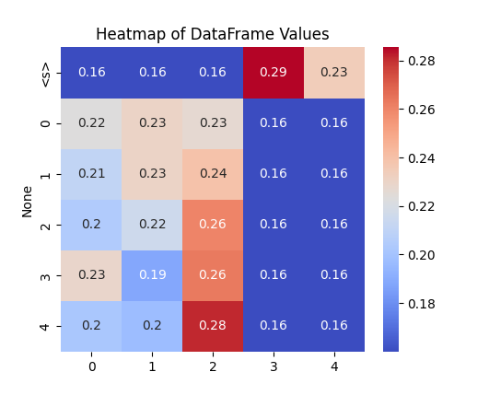
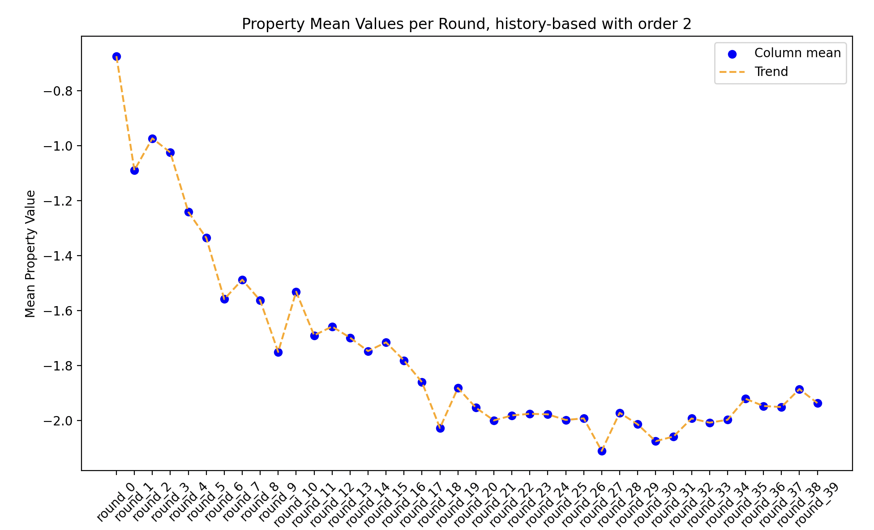
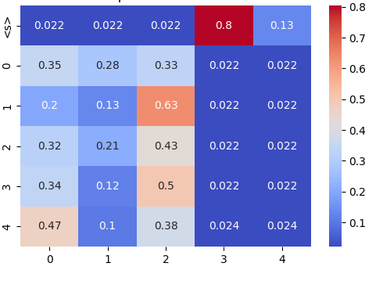
Learning
example
1st round
Rule IDs
10 learning rounds
10th round
Rule IDs
Target value: LogP value = -2.0

Slide 18
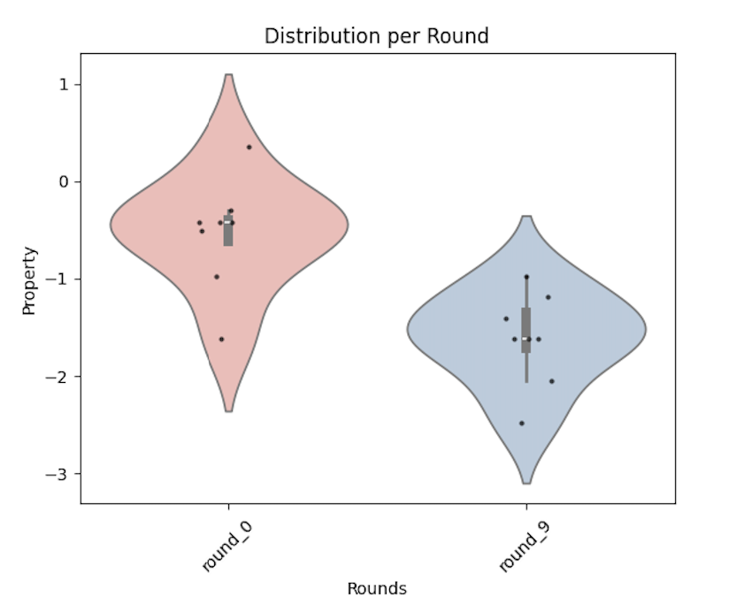
Learning
example
1st round
Rule IDs
10 learning rounds
10th round
Rule IDs
Target value: LogP value = -2.0

Slide 19
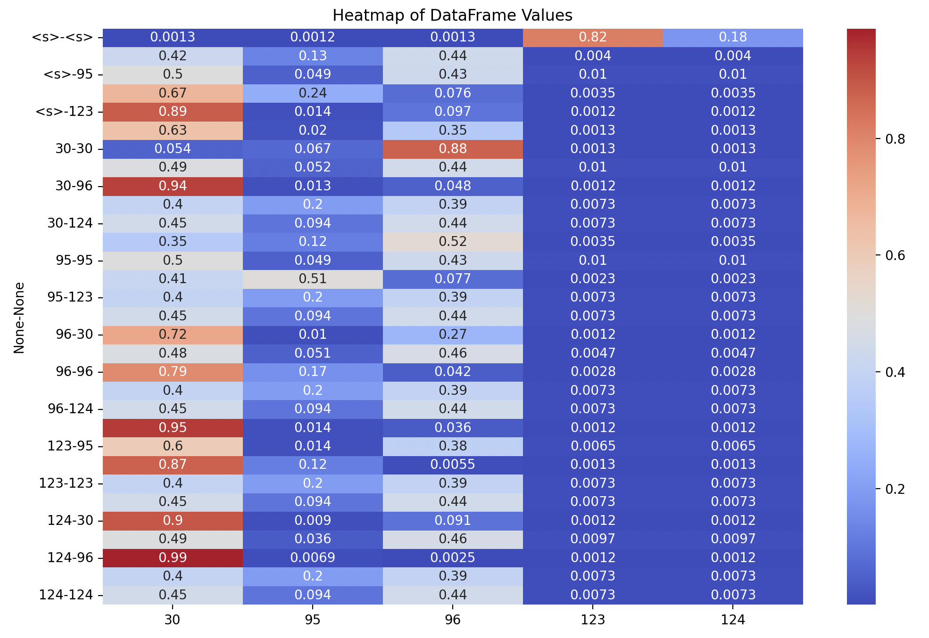
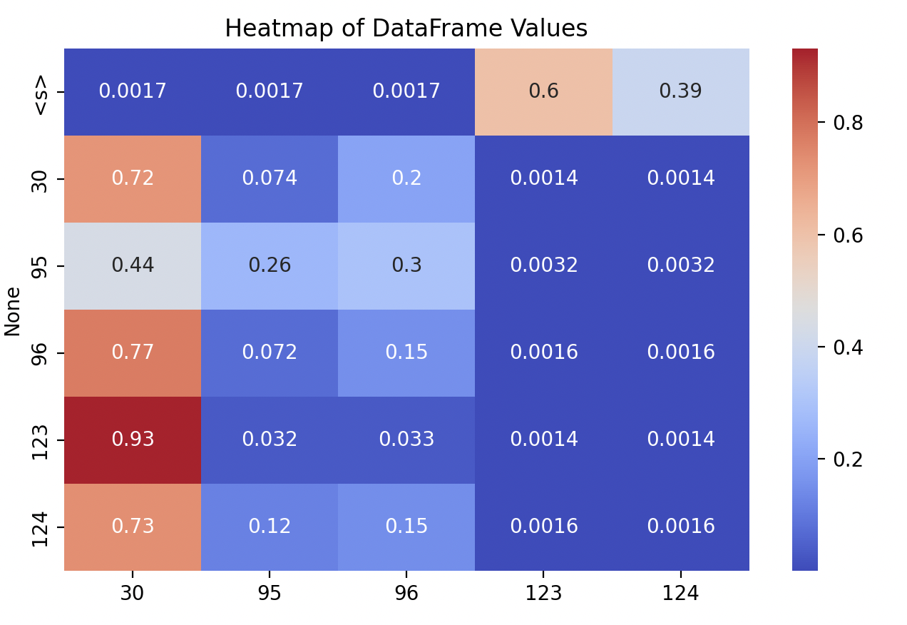
History-based graph grammars
Sequence: r1, r2, r3, r1, r6, r1, r4
Rule IDs
Rule IDs
Order = 2
Order = 3

Slide 20
Additional slides

Slide 21
Sampling
Initial transition matrix, pm
Two first rules are rejected, the last one is accepted
 | S | rule_1 | rule_2 | rule_3
S | 0 | 1/3 | 1/3 | 1/3
rule_1 | 0 | 1/3 | 1/3 | 1/3
rule_2 | 0 | 1/3 | 1/3 | 1/3
rule_3 | 0 | 1/3 | 1/3 | 1/3
S
rule_2
rule_1
rule_3
C
 | S | rule_1 | rule_2 | rule_3
S | 0 | 1/3 | 1/3 | 1/3
 | S | rule_1 | rule_2 | rule_3
S | 0 | 0,5 | 0 | 0,5
 | S | rule_1 | rule_2 | rule_3
S | 0 | 1 | 0 | 0

Slide 22
Sampling
Initial transition matrix, pm
The first rule is accepted
 | S | rule_1 | rule_2 | rule_3
S | 0 | 1/3 | 1/3 | 1/3
rule_1 | 0 | 1/3 | 1/3 | 1/3
rule_2 | 0 | 1/3 | 1/3 | 1/3
rule_3 | 0 | 1/3 | 1/3 | 1/3
S
rule_2
rule_1
rule_3
C
rule_2
 | S | rule_1 | rule_2 | rule_3
rule_1 | 0 | 1/3 | 1/3 | 1/3
E
 | S | rule_1 | rule_2 | rule_3
rule_1 | 0 | 0 | 1 | 0

Slide 23
Sampling
Initial transition matrix, pm
Two first rule is rejected, the second one is accepted
 | S | rule_1 | rule_2 | rule_3
S | 0 | 1/3 | 1/3 | 1/3
rule_1 | 0 | 1/3 | 1/3 | 1/3
rule_2 | 0 | 1/3 | 1/3 | 1/3
rule_3 | 0 | 1/3 | 1/3 | 1/3
S
rule_2
rule_1
rule_3
C
rule_2
 | S | rule_1 | rule_2 | rule_3
rule_2 | 0 | 1/3 | 1/3 | 1/3
E
 | S | rule_1 | rule_2 | rule_3
rule_1 | 0 | 0,5 | 0 | 0,5
rule_2
rule_3
M
 | S | rule_1 | rule_2 | rule_3
rule_1 | 0 | 0 | 0 | 1

Slide 24
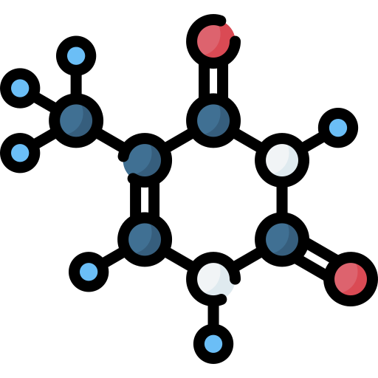

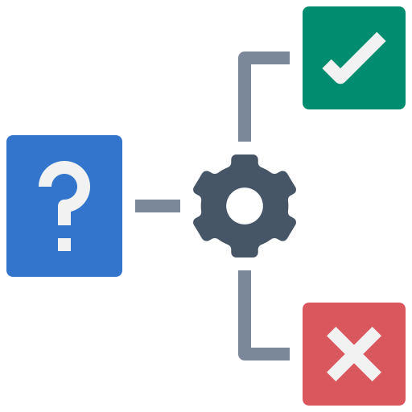
Pipeline for grammar generation
Frequent subgraph mining
MØD
Applying rules
Extracting rules
X
Threshold = 1
Molecules
Threshold = 1 - 0.1
Rules
Frequent subgraphs
Contracted molecules
***
isomorphism
check
***
monomorphism
check
***
isomorphism
check
If no subgraphs extracted
lose threshold
Stops when :
Molecules = Frequent subgraphs
Termination rules

